Slide 1


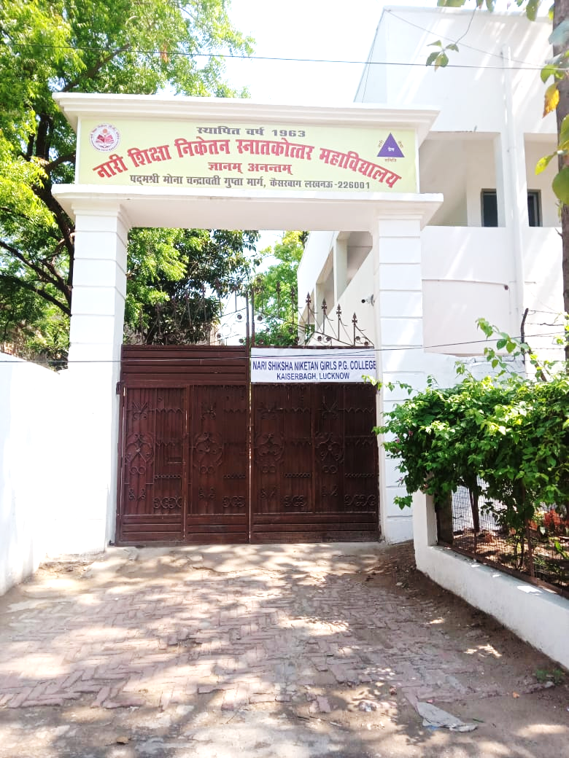
Nari Shiksha Niketan PG College, Lucknow
Introduction
Nari Shiksha Niketan PG College is Government- aided and NAAC accredited.
It is associated college of the University of Lucknow.
The College believes in imparting holistic education to the students who are enrolled in - Arts, Science and Commerce.
The faculty of Arts offers 14 subjects and a Post- Graduate course, M.A. Hindi while 4 subjects are offered in the science faculty and all regular courses.
The Commerce faculty and B.A. Psychology are self-financing courses.

Slide 2
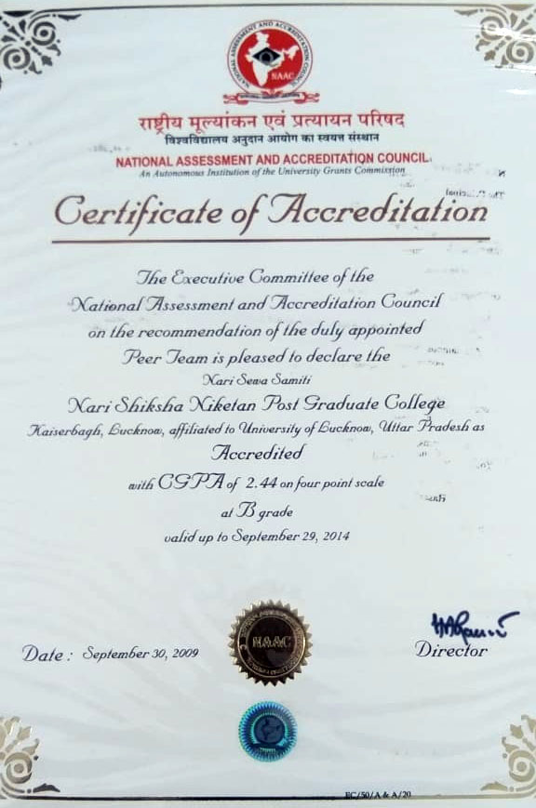
Nari Shiksha Niketan PG College
Accredited with B+ Grade in 2009.

Slide 3
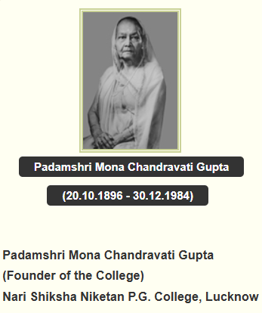
Padamshri: Mona Chandravati Gupta
Mona Chandravati Gupta was born on October 20th, 1896 in Rangoon, Burma (now Myannmar). Her early education was in Rangoon and London.
She graduated from the Diocesan College in Calcutta and was appointed the Vice Principal of the Government Girls College in Lucknow. Simultaneously in 1934-35 Mona Chandravati Gupta was appointed on the Committee to Review University Education for Women.
In 1965, she was awarded the Padama-Shri for outstanding services for the welfare of women and children.
She inspired her son Mr Mahesh Chandra, who later on became founder's representative and devoted his 40 years for the problems and future policies of the Nari Sewa Samiti.
At present her grand daughter-in-law Ms Piya Krishna is founder's representative of Nari Sewa Samiti.

Slide 4
ABOUT THE INSTITUTION
Nari Shiksha Niketan PG College is an esteemed institution affiliated with the University of Lucknow. Established on July 16th, 1963, under the UGC Regulation Act 1956, our college has been a pioneer in women's education in Lucknow. Initially offering Science courses, the college expanded its academic horizon in 1994 by introducing M.A. classes in Hindi, marking the commencement of post-graduate programs.
Established | 1963
Graduation Courses | BA, BCom & BSc
Post Graduation Courses | MA
Students | 1000
Full-time and Part-time Faculty | 35

Slide 5
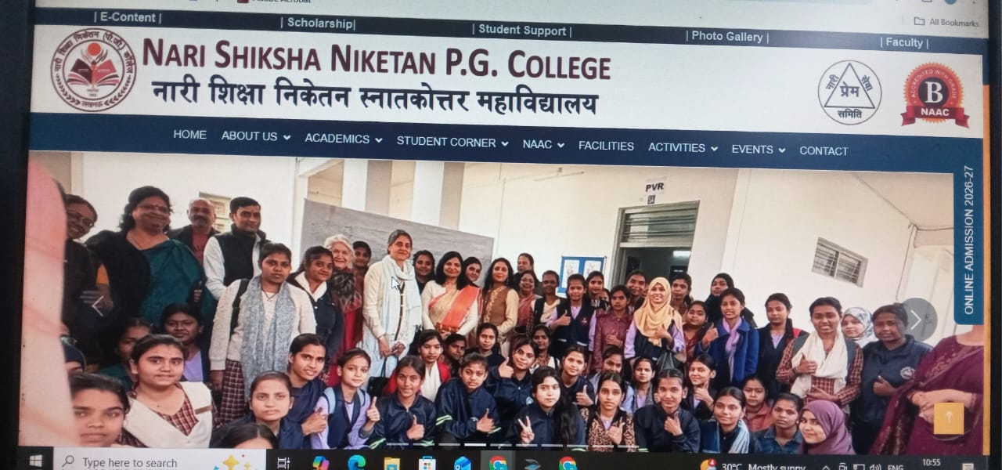
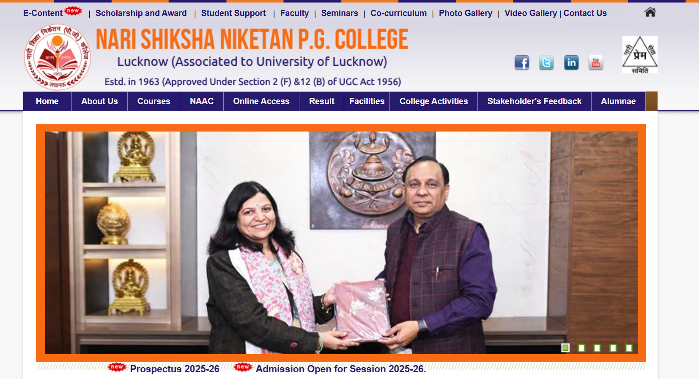
Official Website- https://narishikshaniketanpgcollege.ac.in

Slide 6
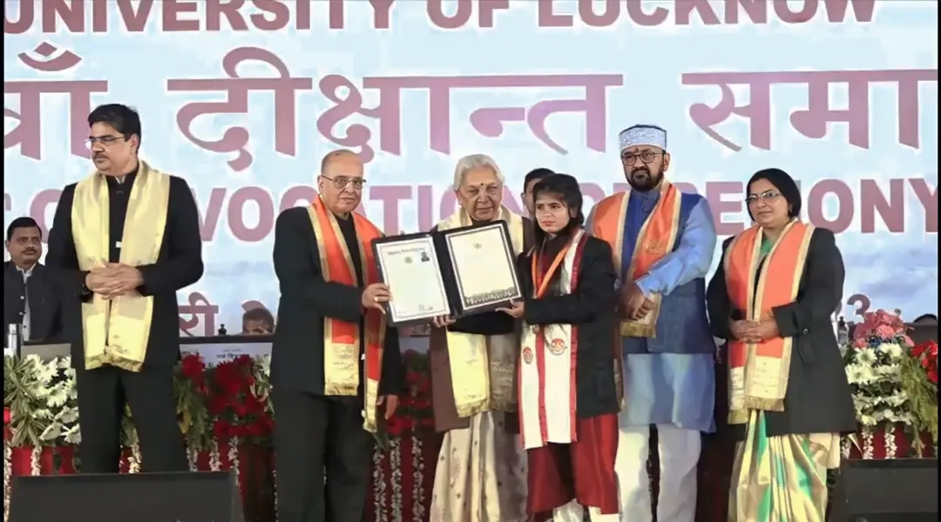
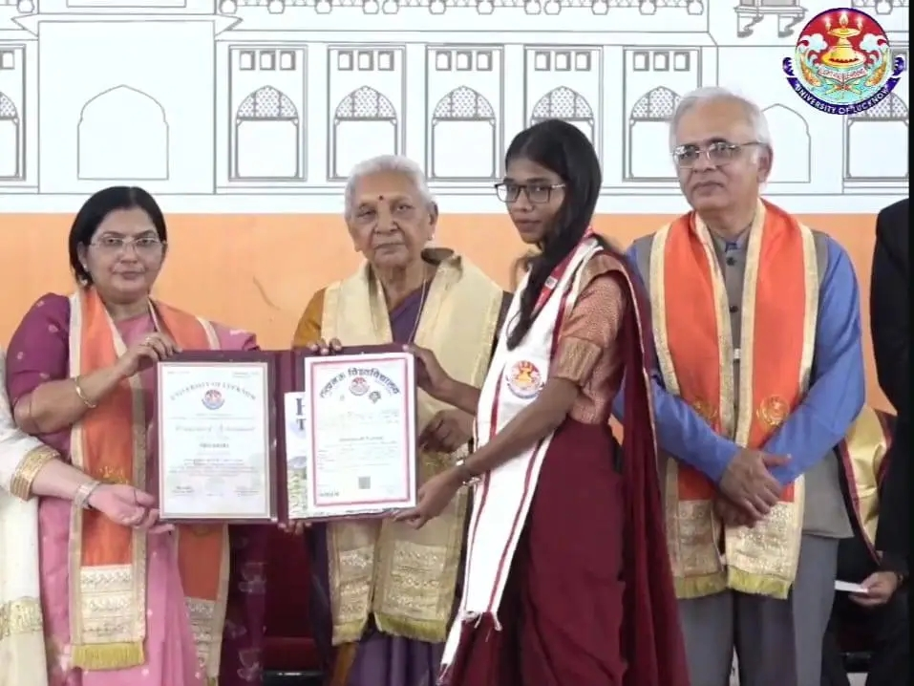
Results- Our GOLD MEDALISTS
TANU AWASTHI, received Gold Medal in 65th Convocation Ceremony of Lucknow University on 21st January, 2023.
SHIVANSHI YADAV received a Gold Medal in the 68th Convocation Ceremony of Lucknow University, 2025.

Slide 7
Faculty Details
Currently, 29 permanent faculty members are serving the college.
There are 3 guest faculty members in various departments such as Hindi, Sanskrit, and Psychology.
There are 3 faculty members in Ad hoc positions in the Commerce Dept.
Non Academic
The college has 3 Lab Assistants.
The college has 2 office staff members.
There is 1 library clerk.

Slide 8
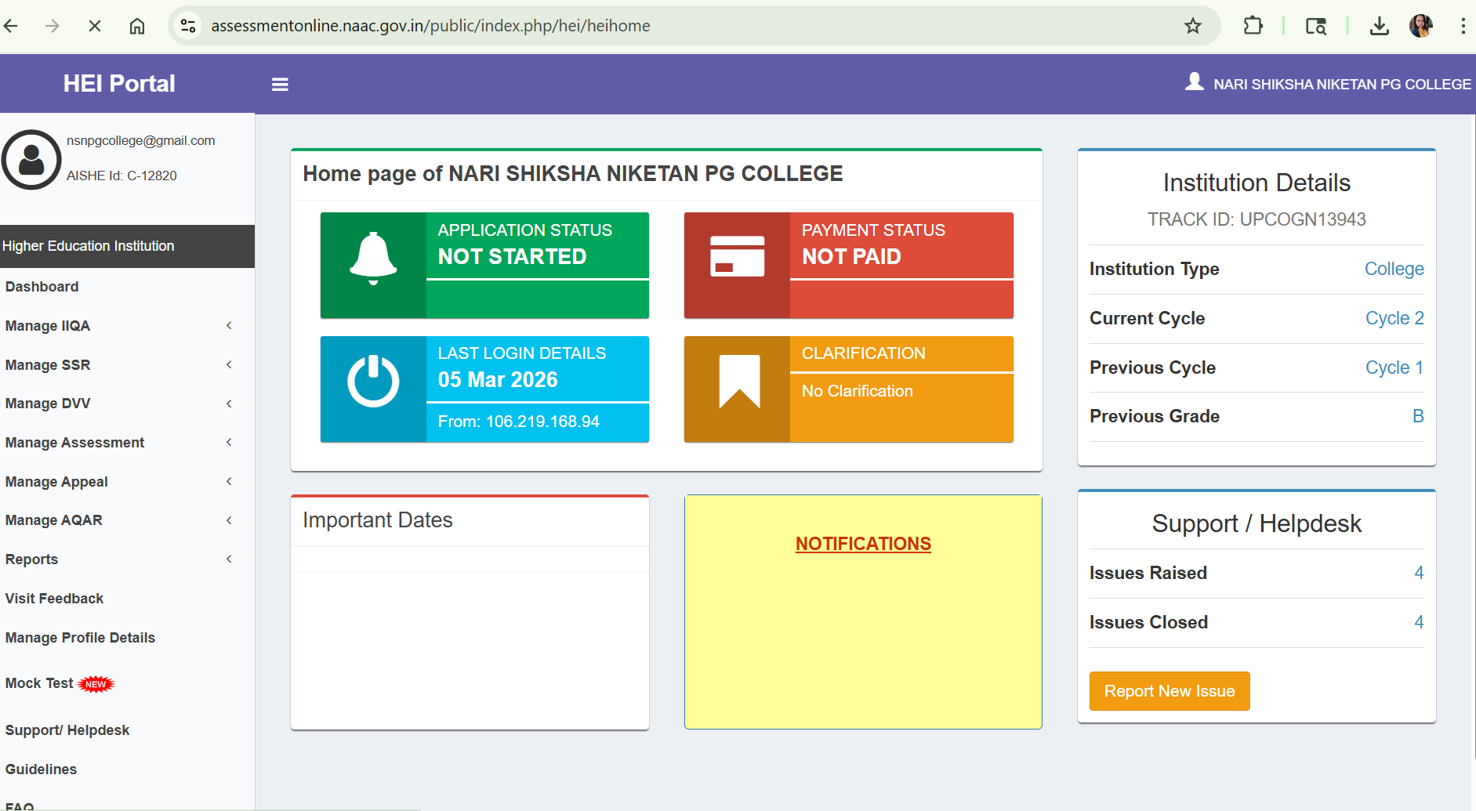
NAAC ( Submitted 4 AQAR)

Slide 9
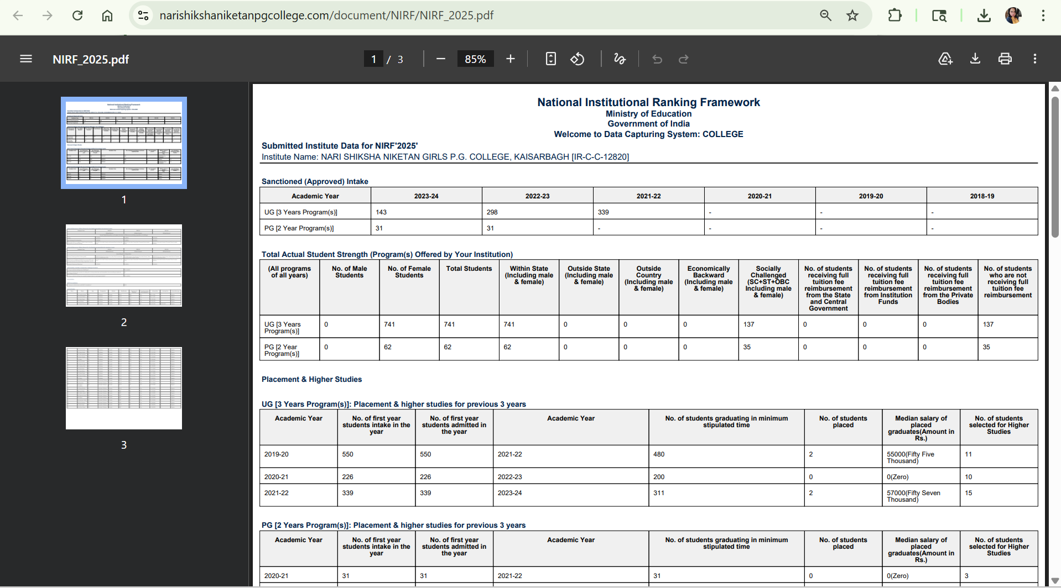

NIRF 2025

Slide 10
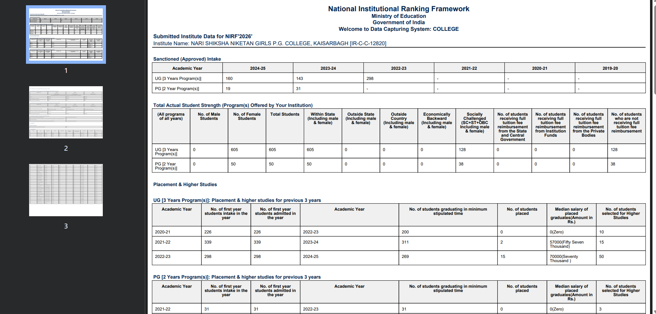
NIRF 2026

Slide 11

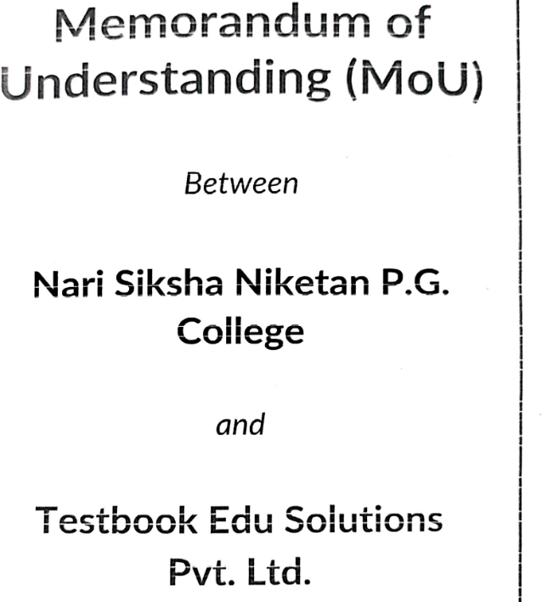
Memorandum of Understanding (MoU)
The college also signed four MOUs with various organizations during the last three years (2022–2025).
Like Mahnidra, Nandi Foundation, Test Book Edu Solutions Pvt. Ltd. And with UPTOSKILLS.

Slide 12
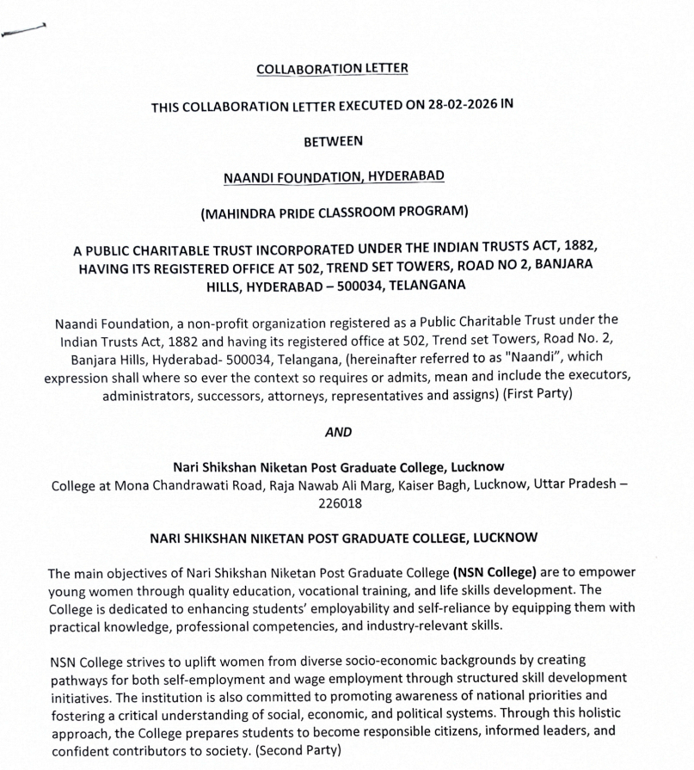
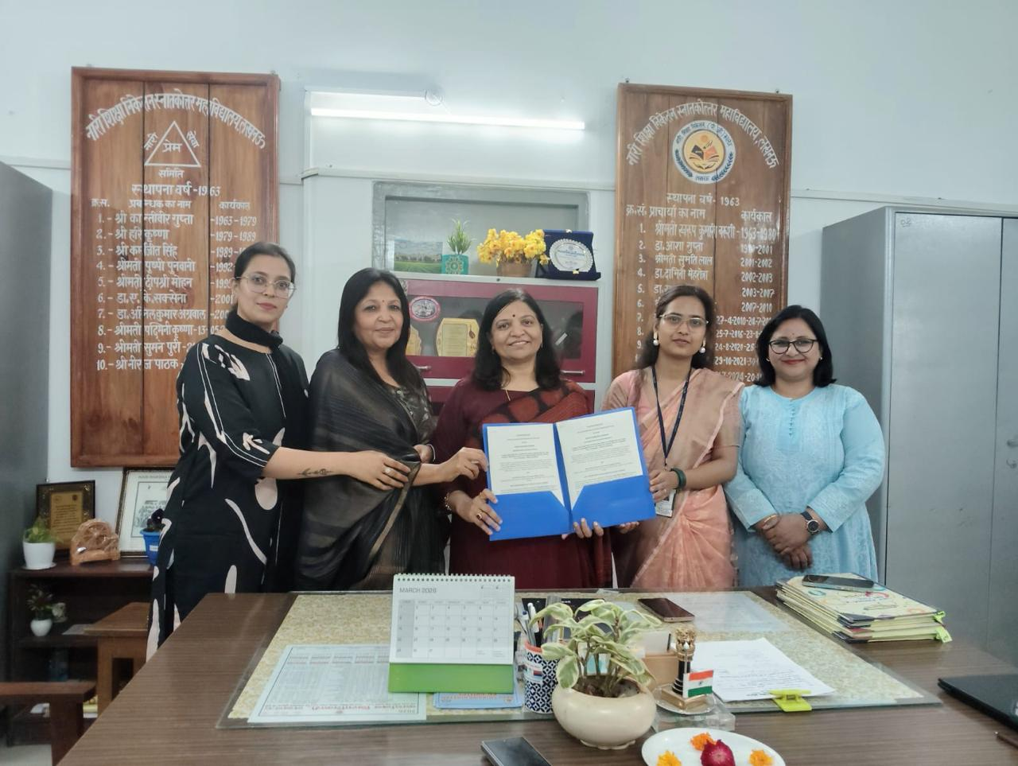
MOU
MOU was signed on 27. 2. 2026 between Mahindra Pride Classroom (a CSR initiative ) , Naandi Foundation and The College.An employability skills training Program will be conducted in the College for 6 days Under the Coordinator ship of English Department.

Slide 13
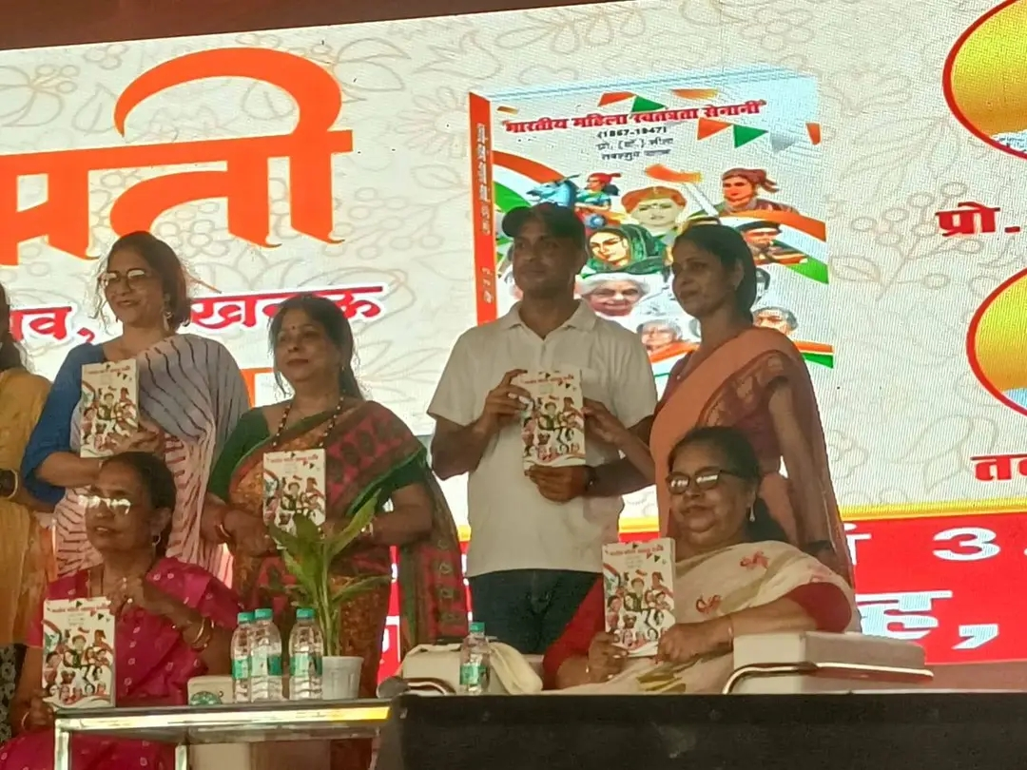
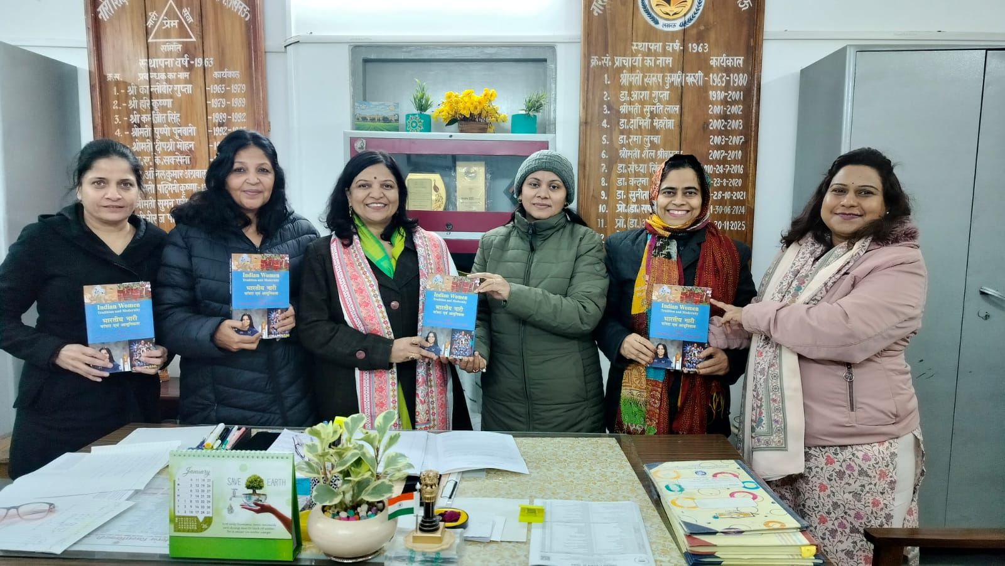
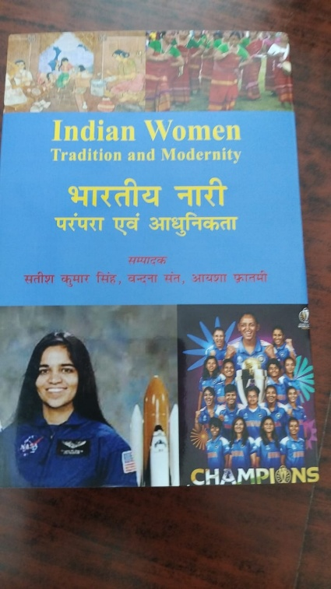
Publications

Slide 14
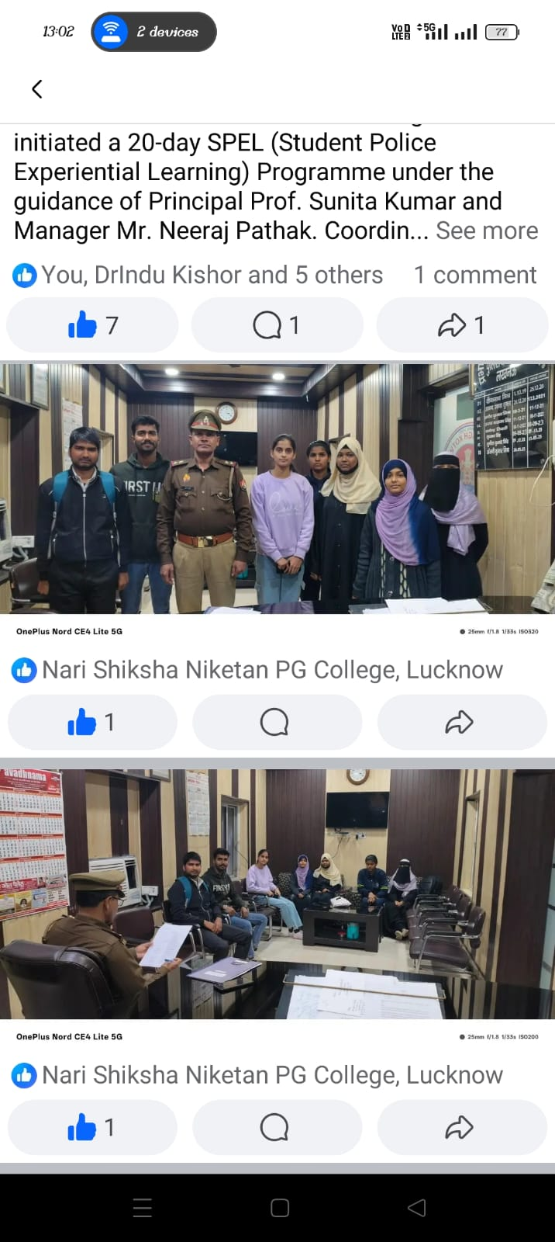
Session 2024-26
Internship

Slide 15
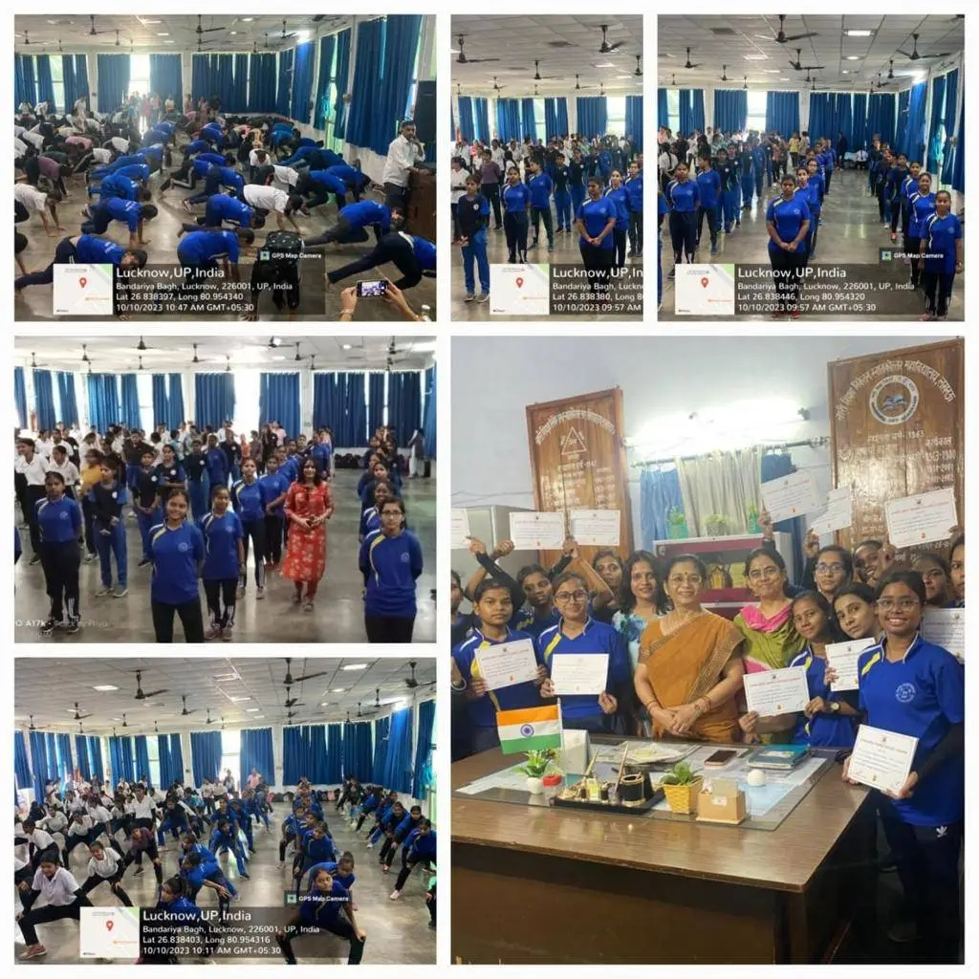

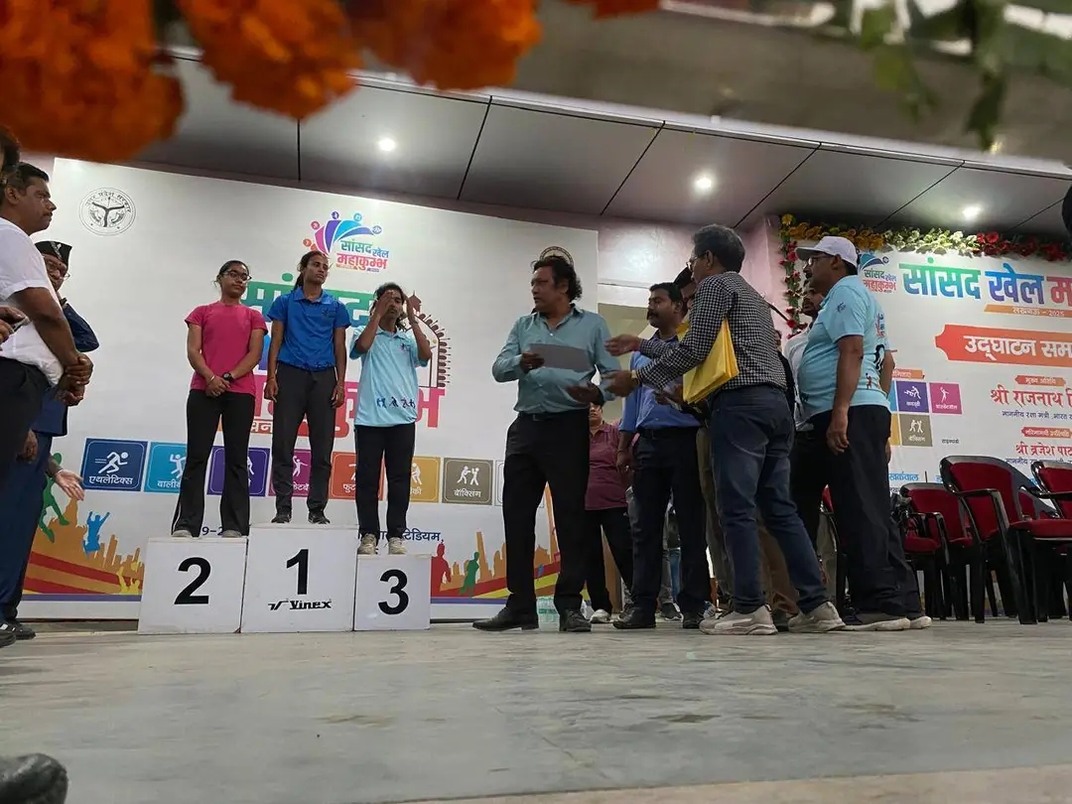
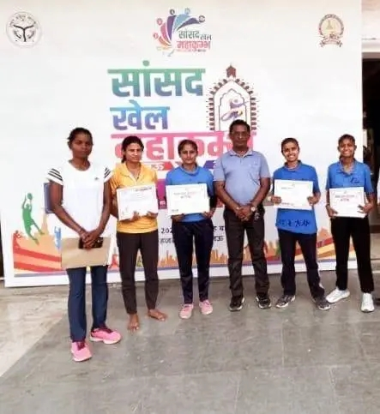
Physical Education/Sports
Session- 2023-26

Slide 16
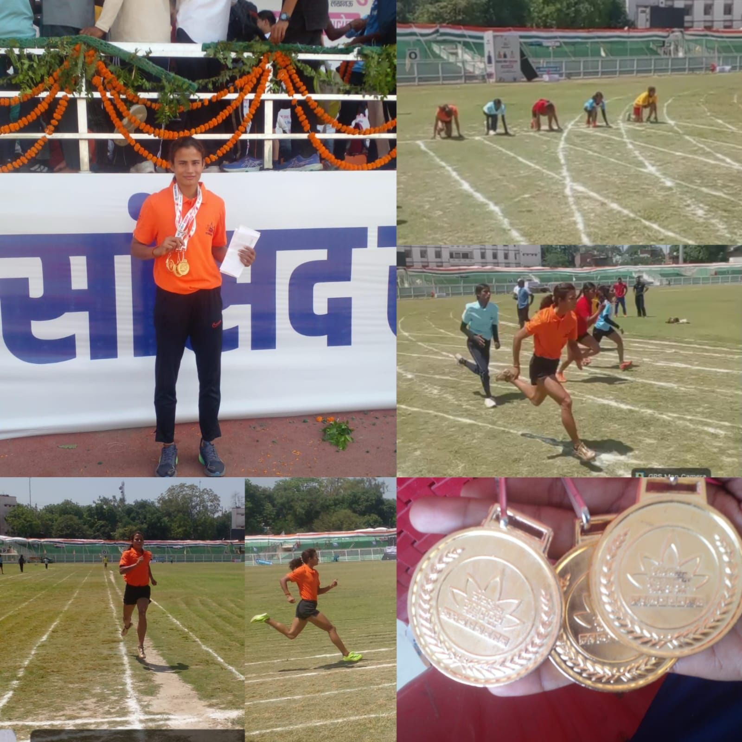
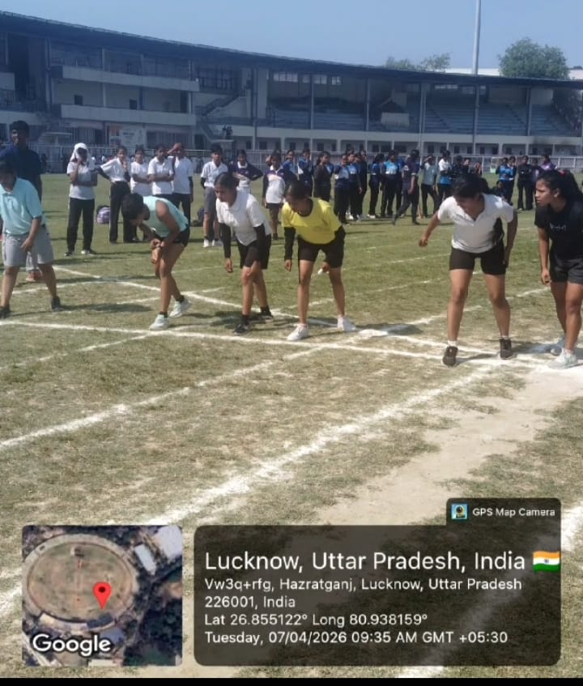
Sports Tournament

Slide 17
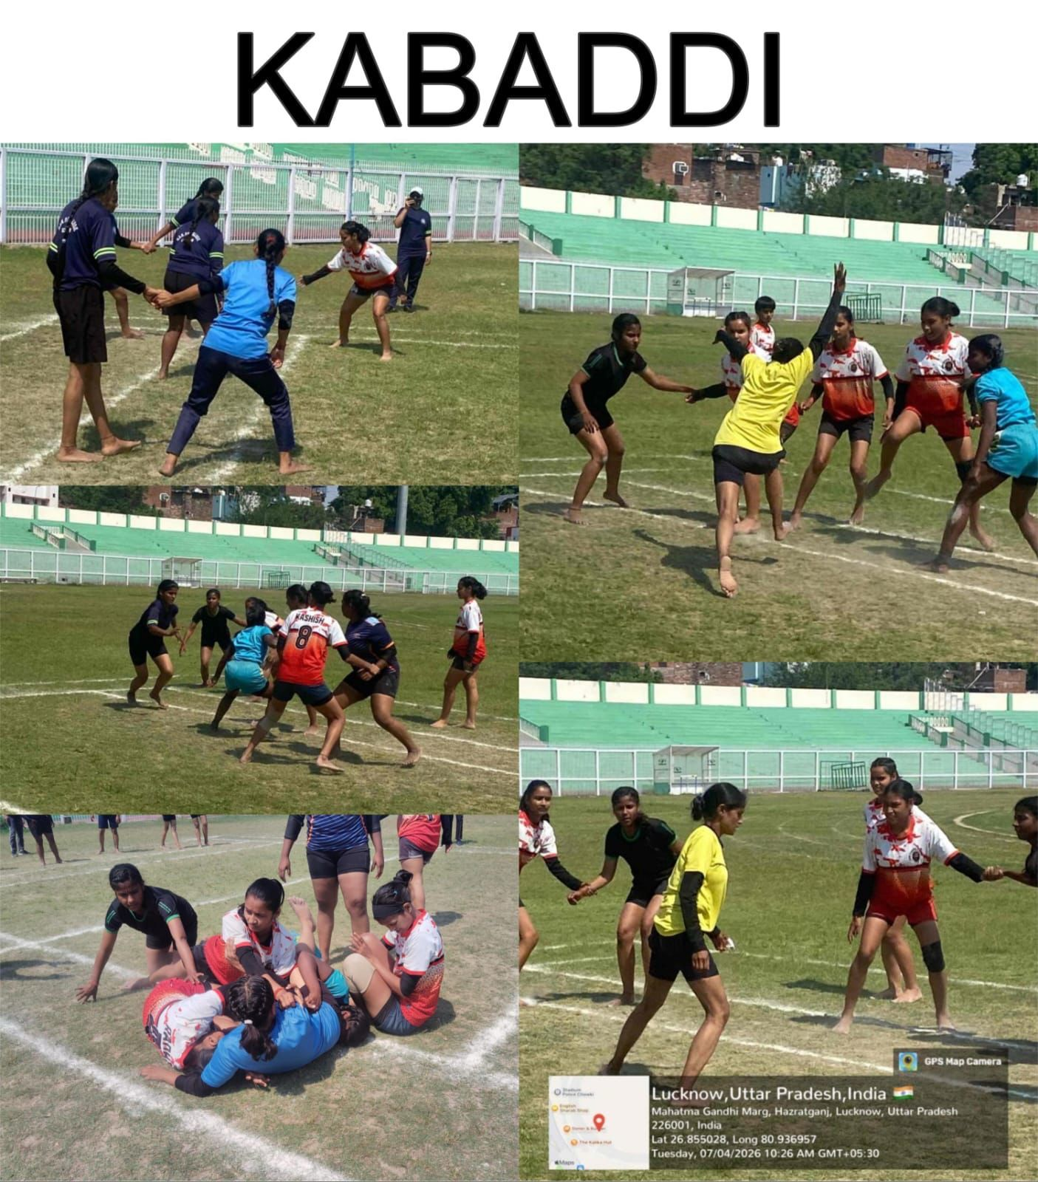
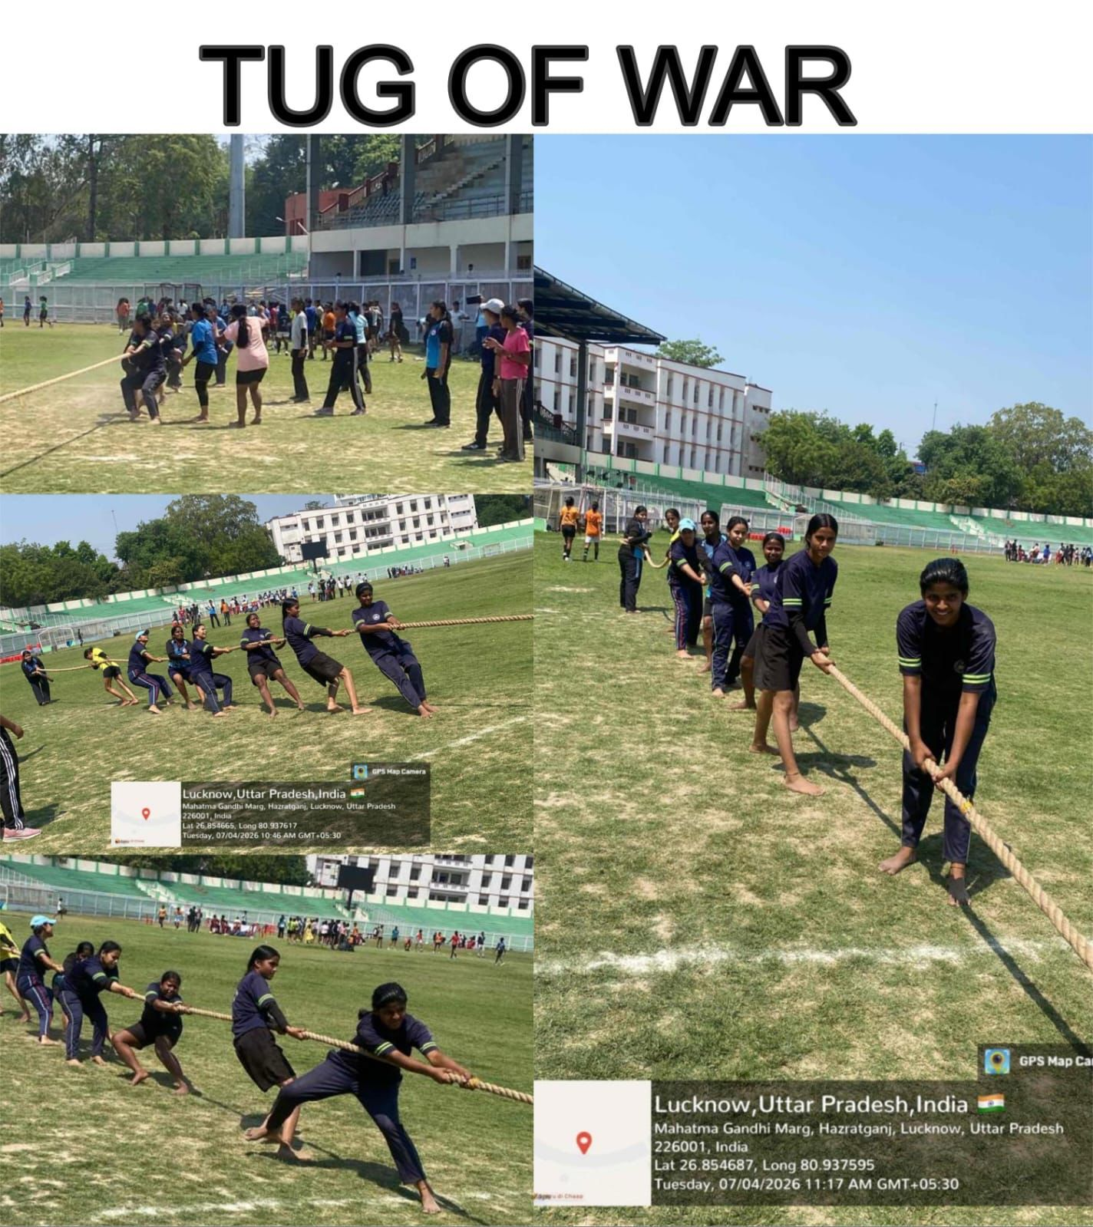

Slide 18
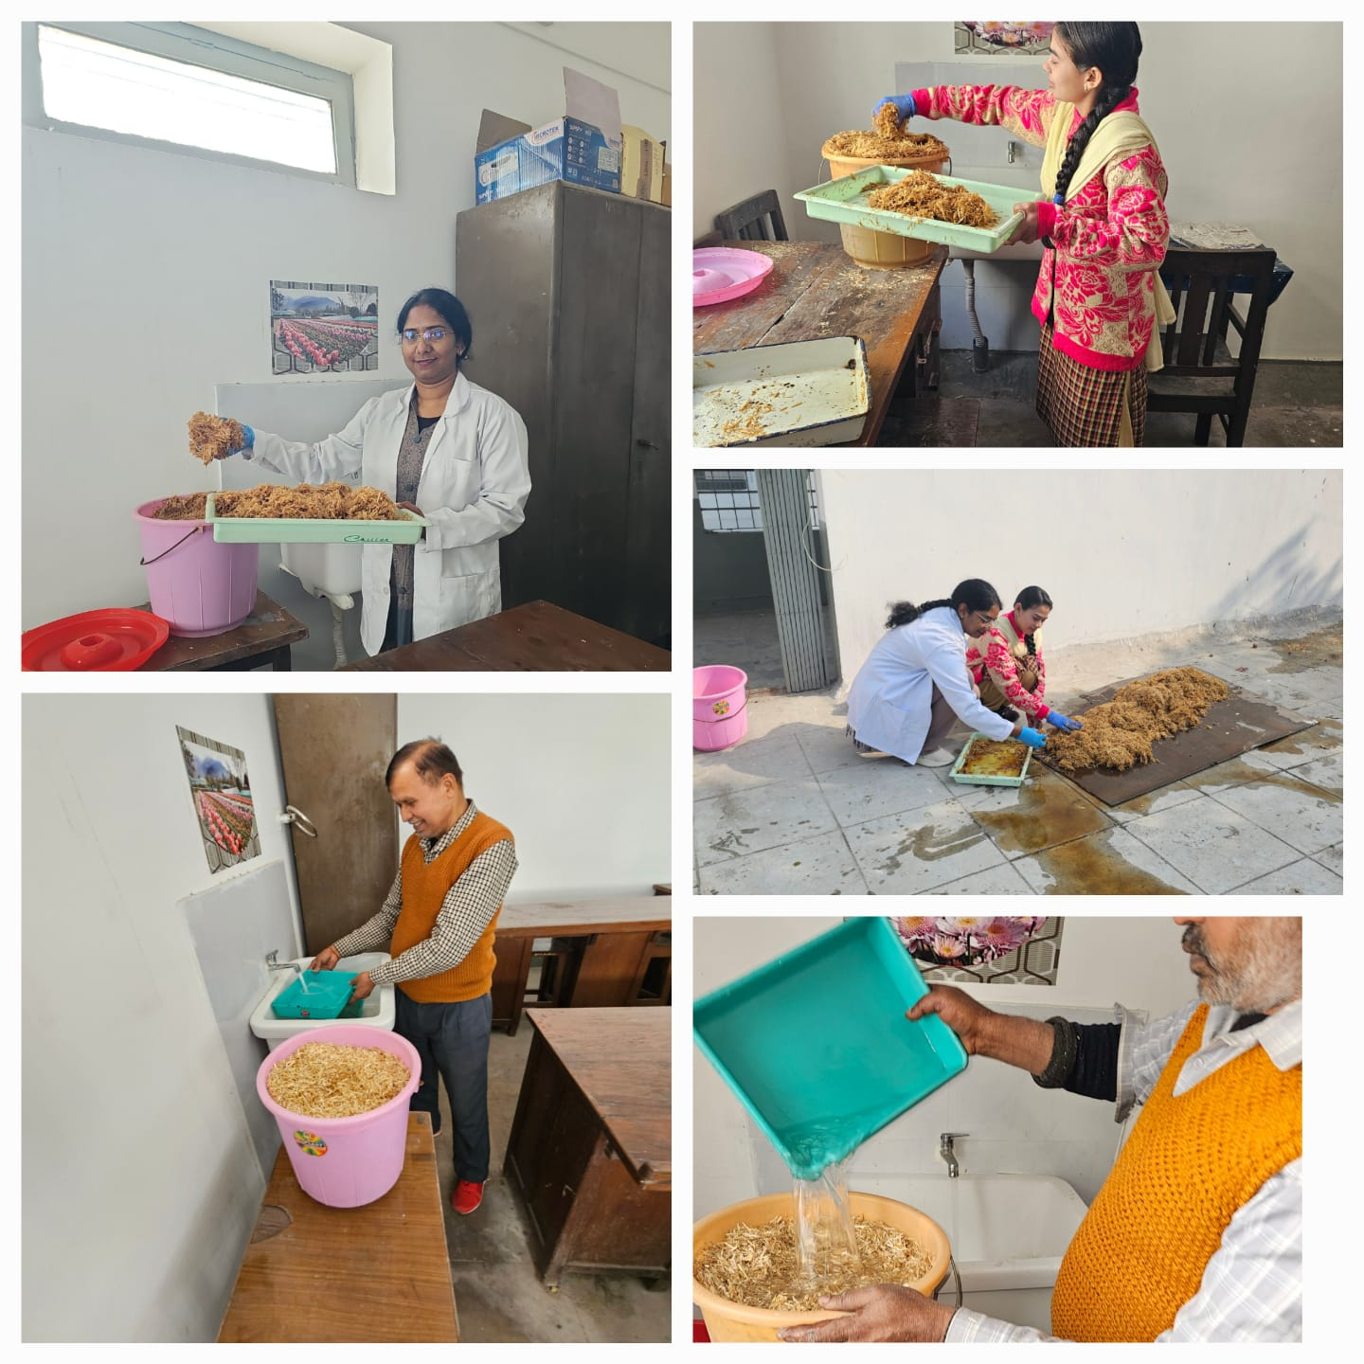
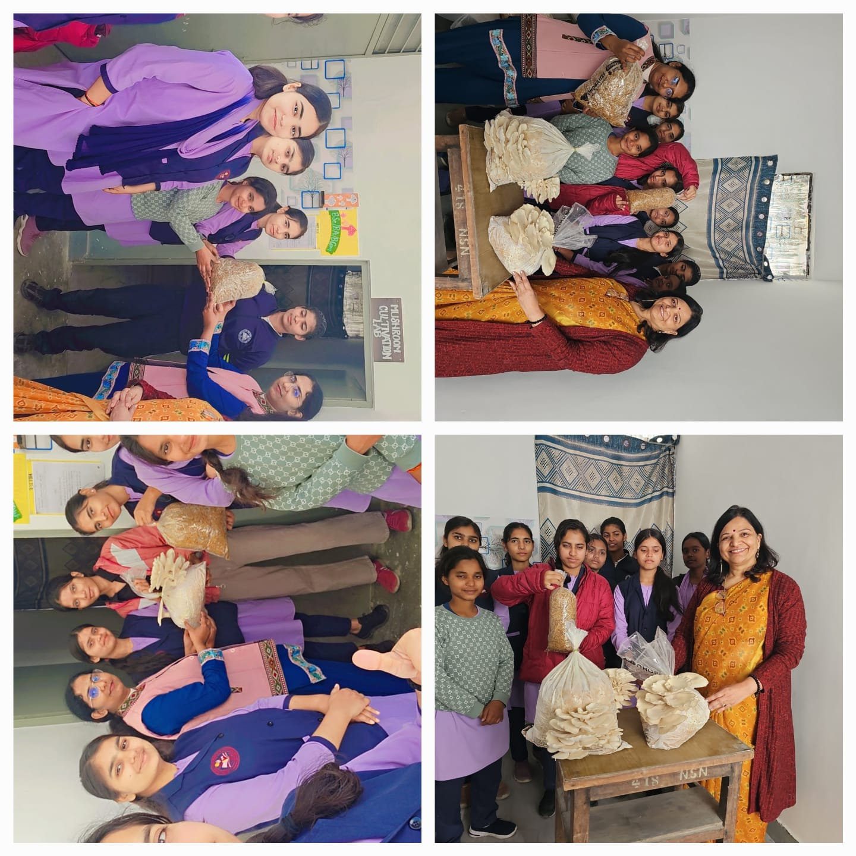
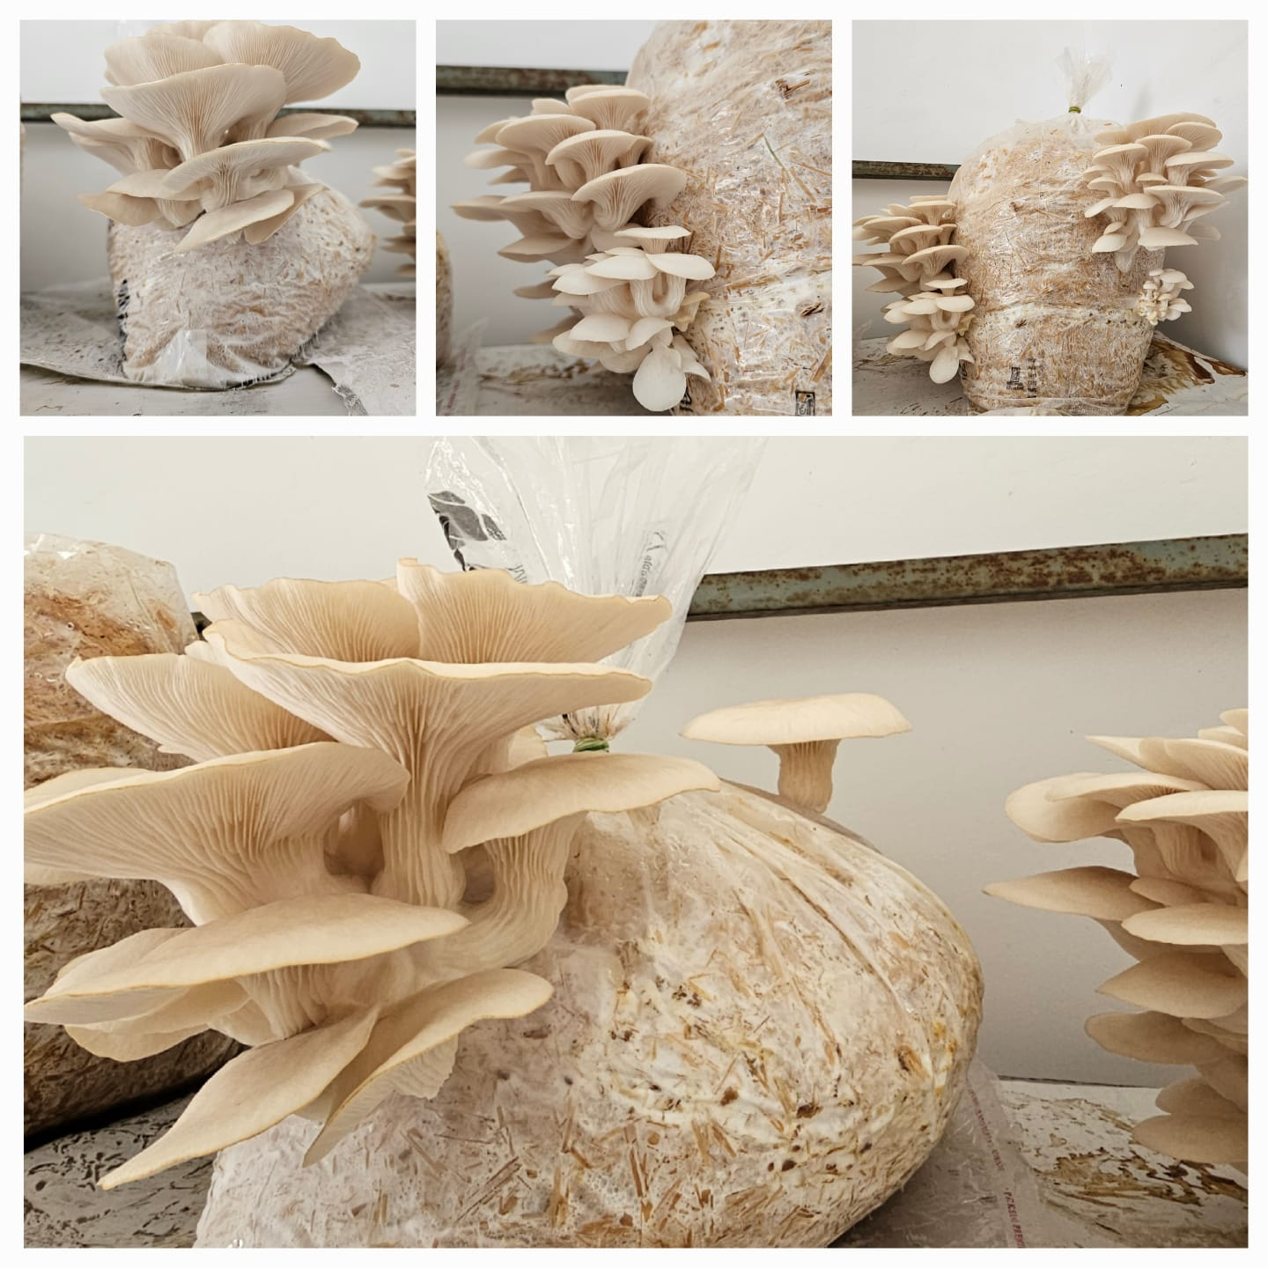
Vocational Course
नारी शिक्षा निकेतन पीजी कॉलेज, लखनऊ में वनस्पति विज्ञान विभाग द्वारा छात्राओं के अंदर उद्यमिता कौशल विकसित करने के लिए वोकेशनल कोर्स (व्यावसायिक पाठ्यक्रम) के अंतर्गत आयॅस्टर (ढिंगरी) मशरूम का उत्पादन शुरू किया गया है।

Slide 19
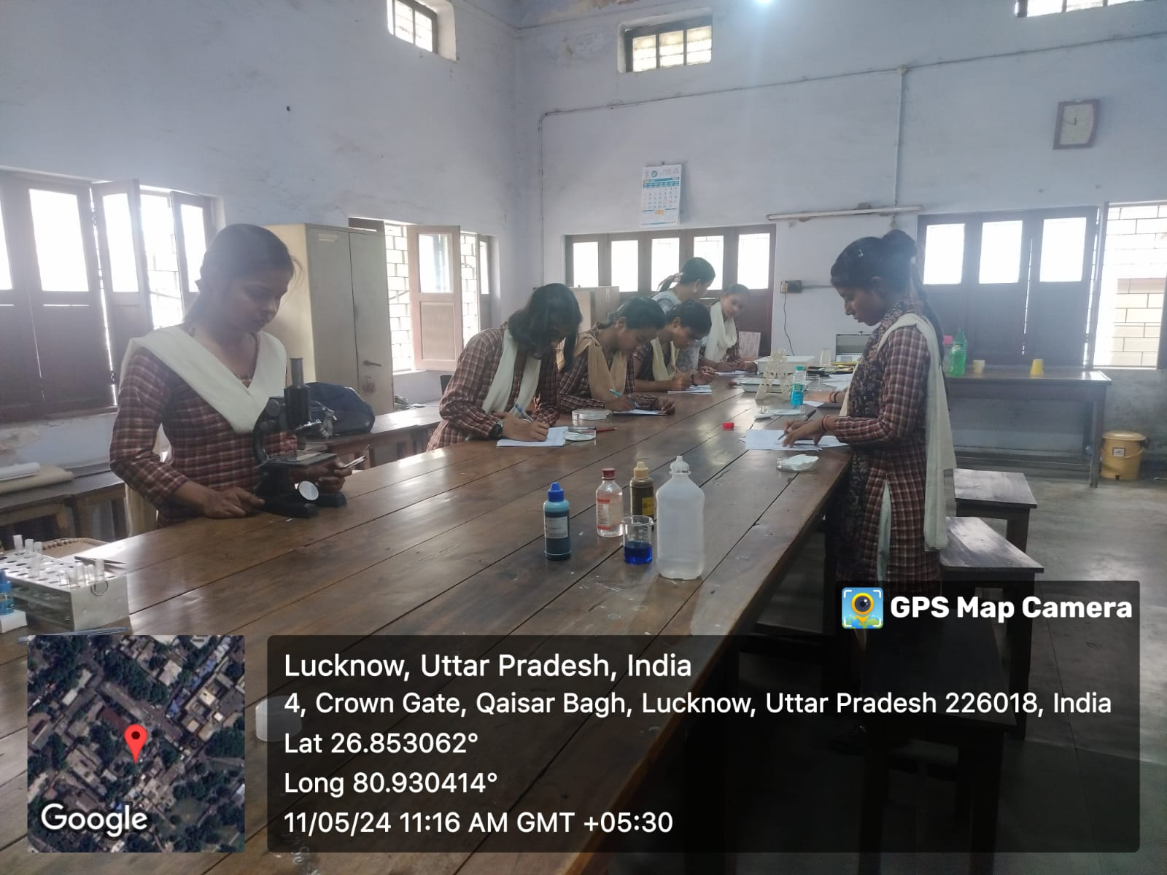
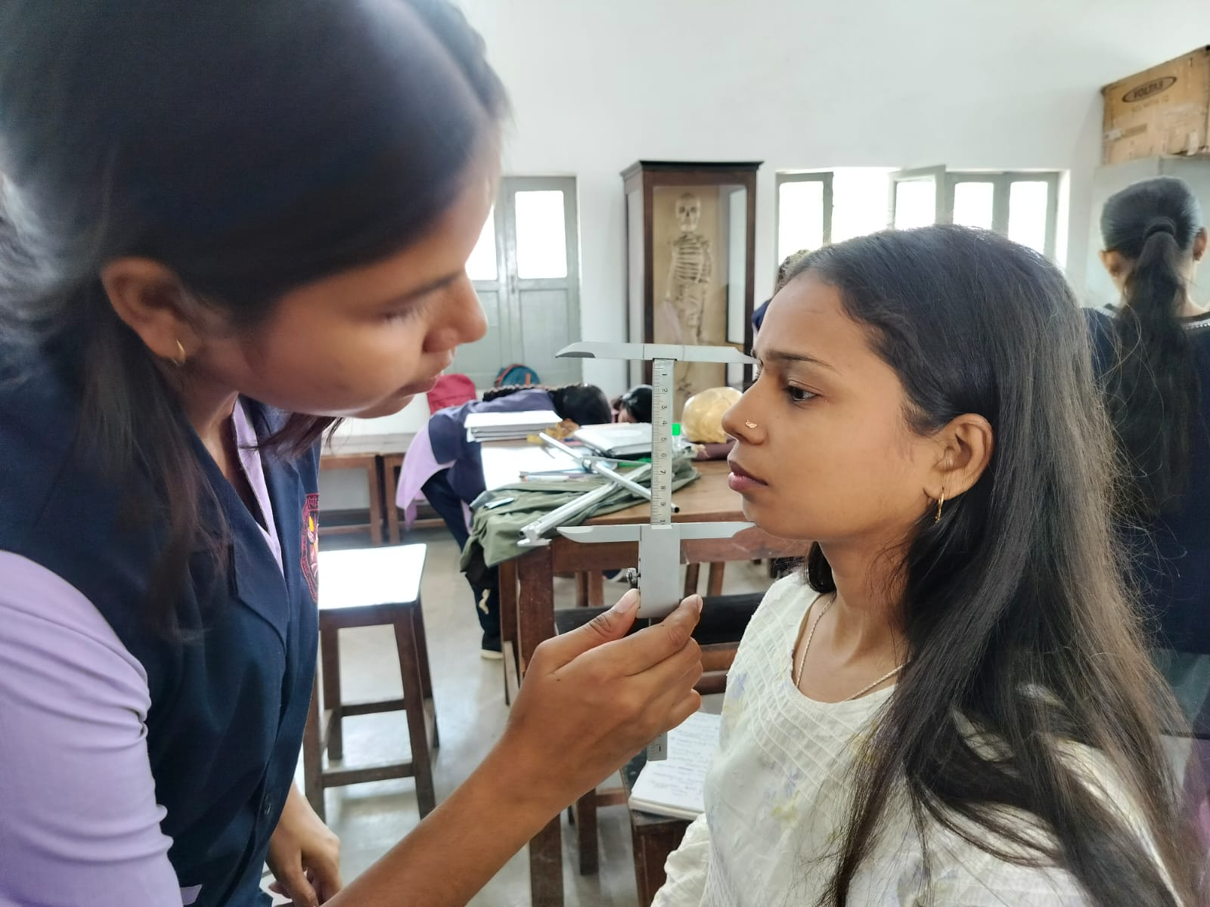
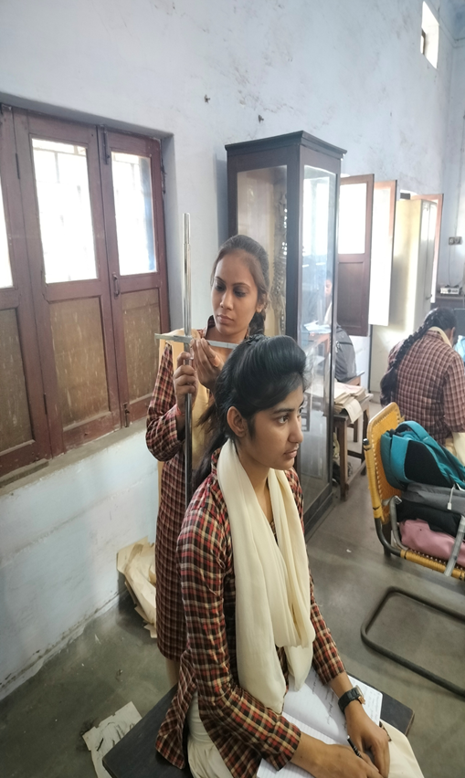
ANTHROPOLOGY LAB
Somatometric Measurements
Serology (Blood group testing)

Slide 20
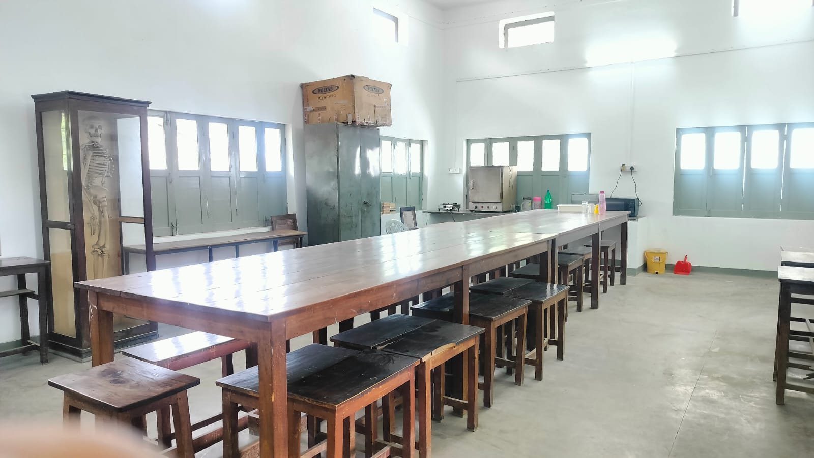
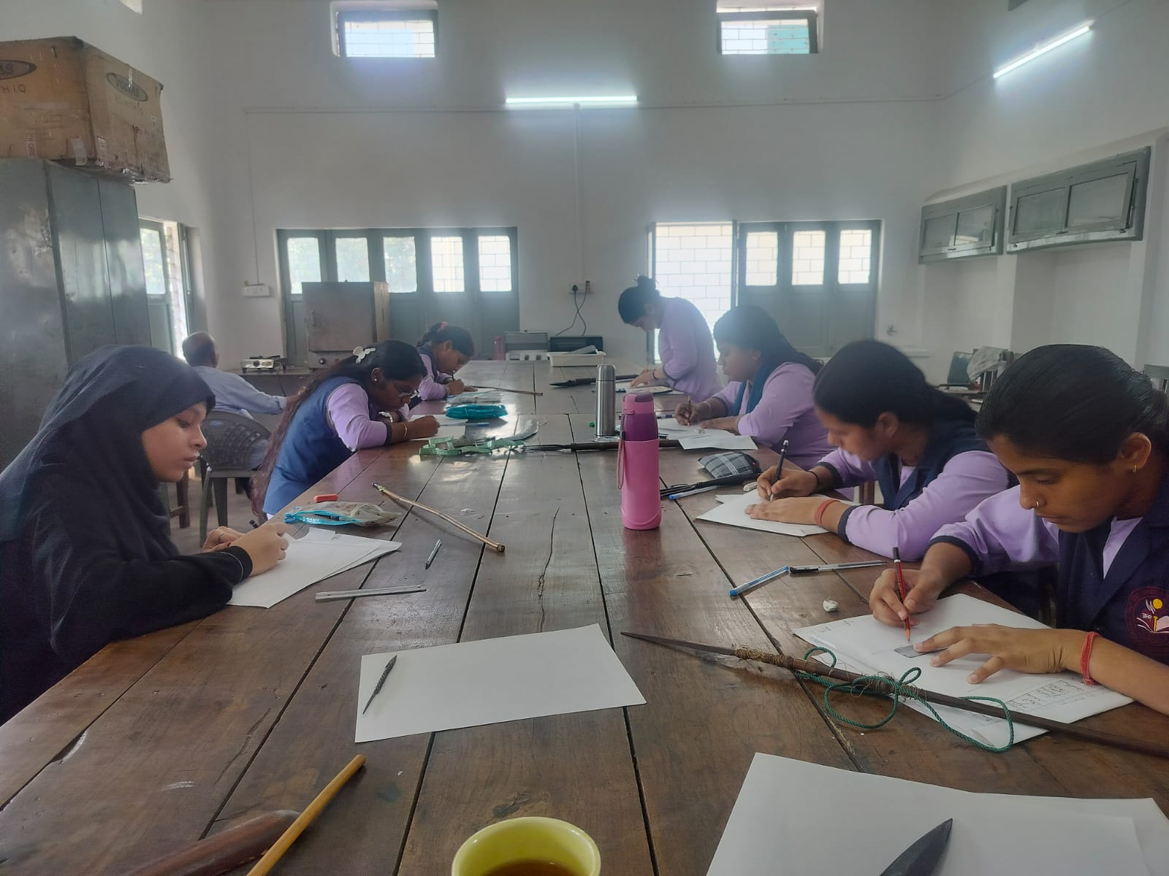
Anthropology Lab

Slide 21
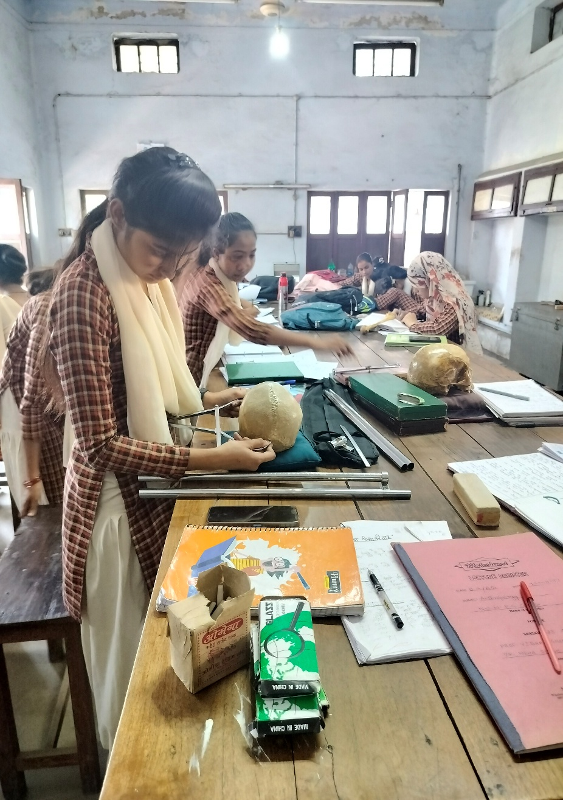
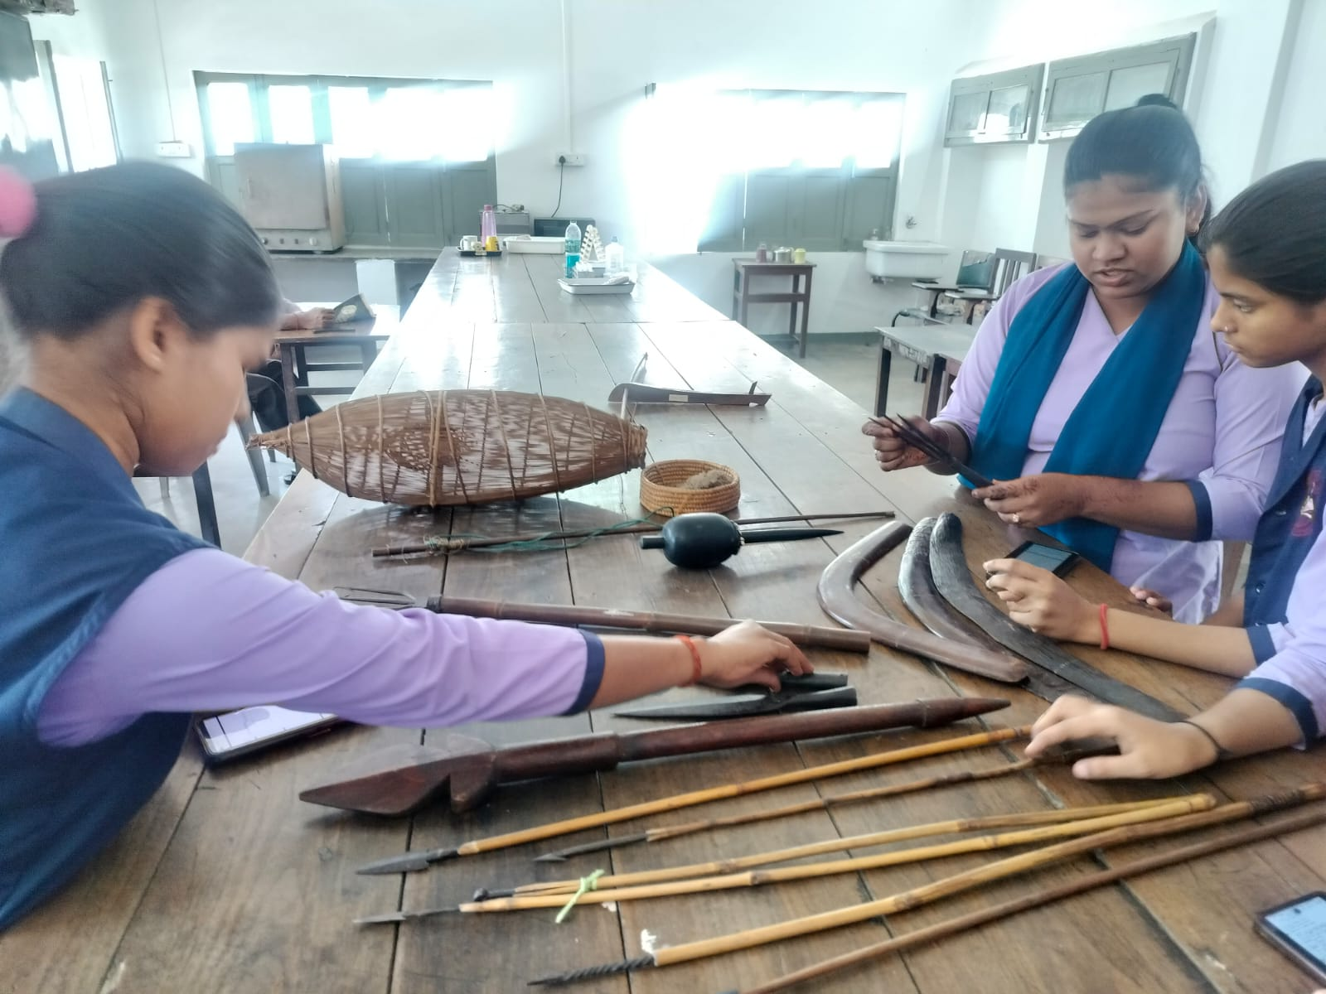
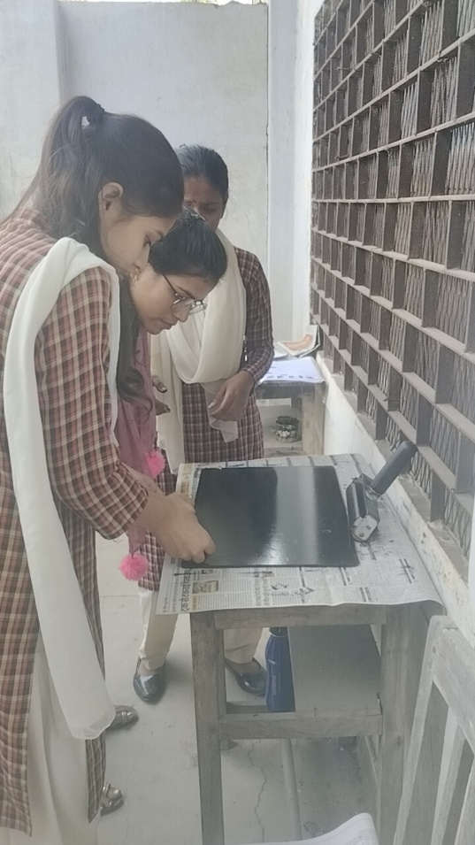
Dermatoglyphics
Craniometric Measurements
Material Culture

Slide 22
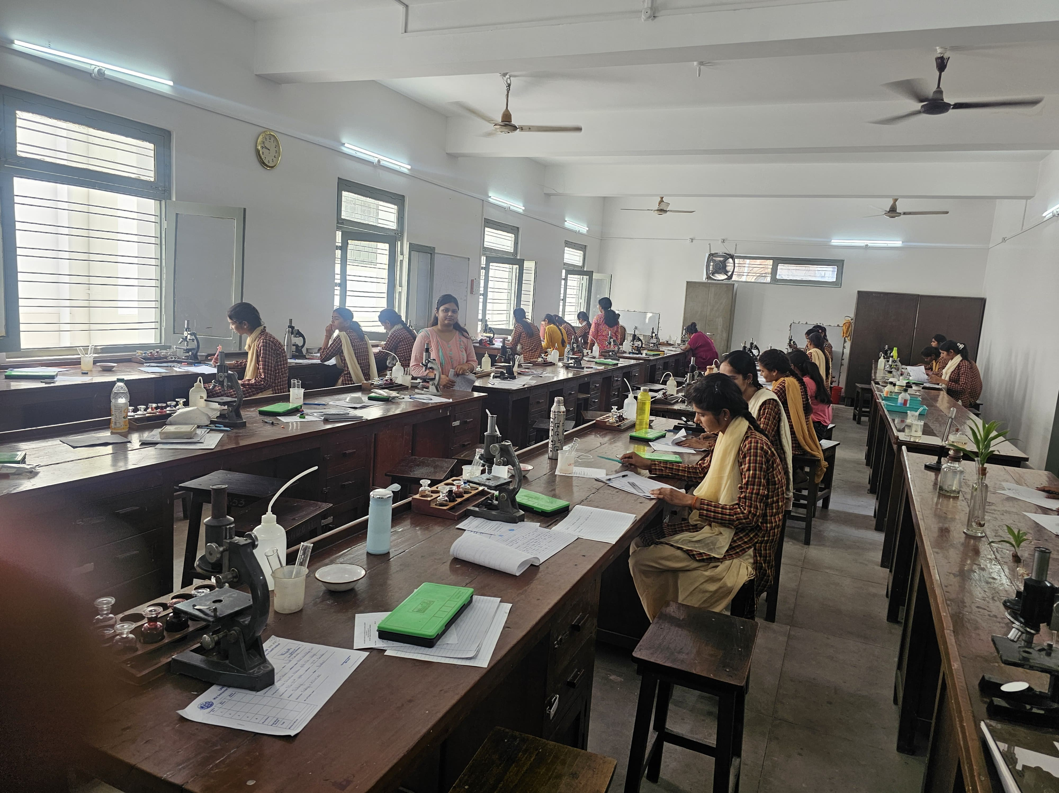
BOTANY LAB

Slide 23
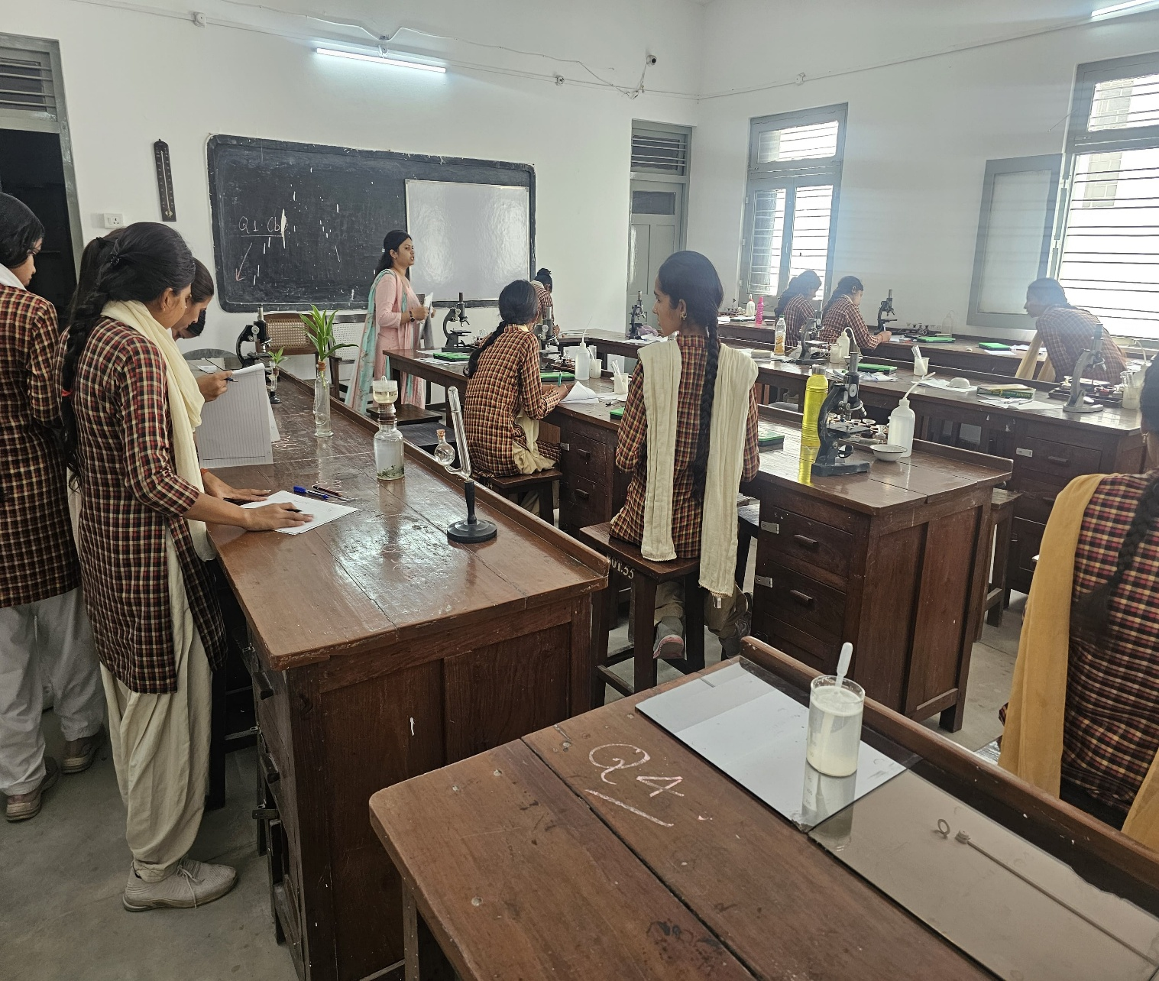
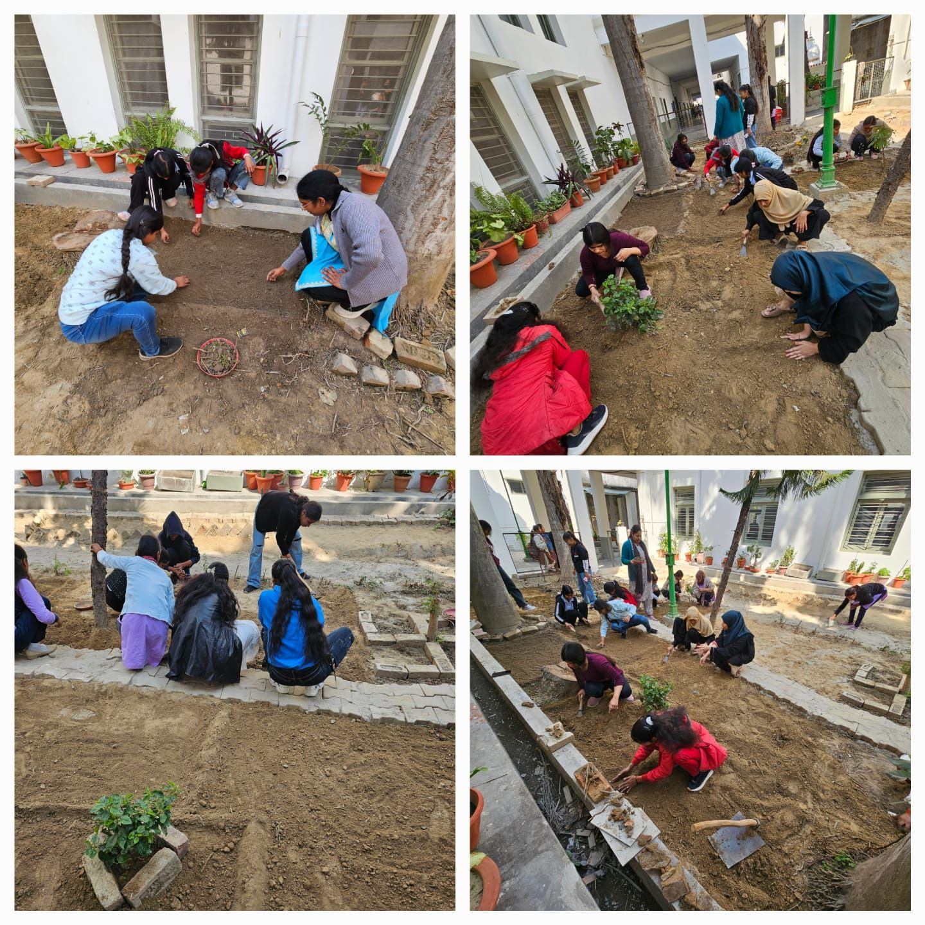
Botany Lab
Outdoor Sapling Planting (Botany Department)

Slide 24
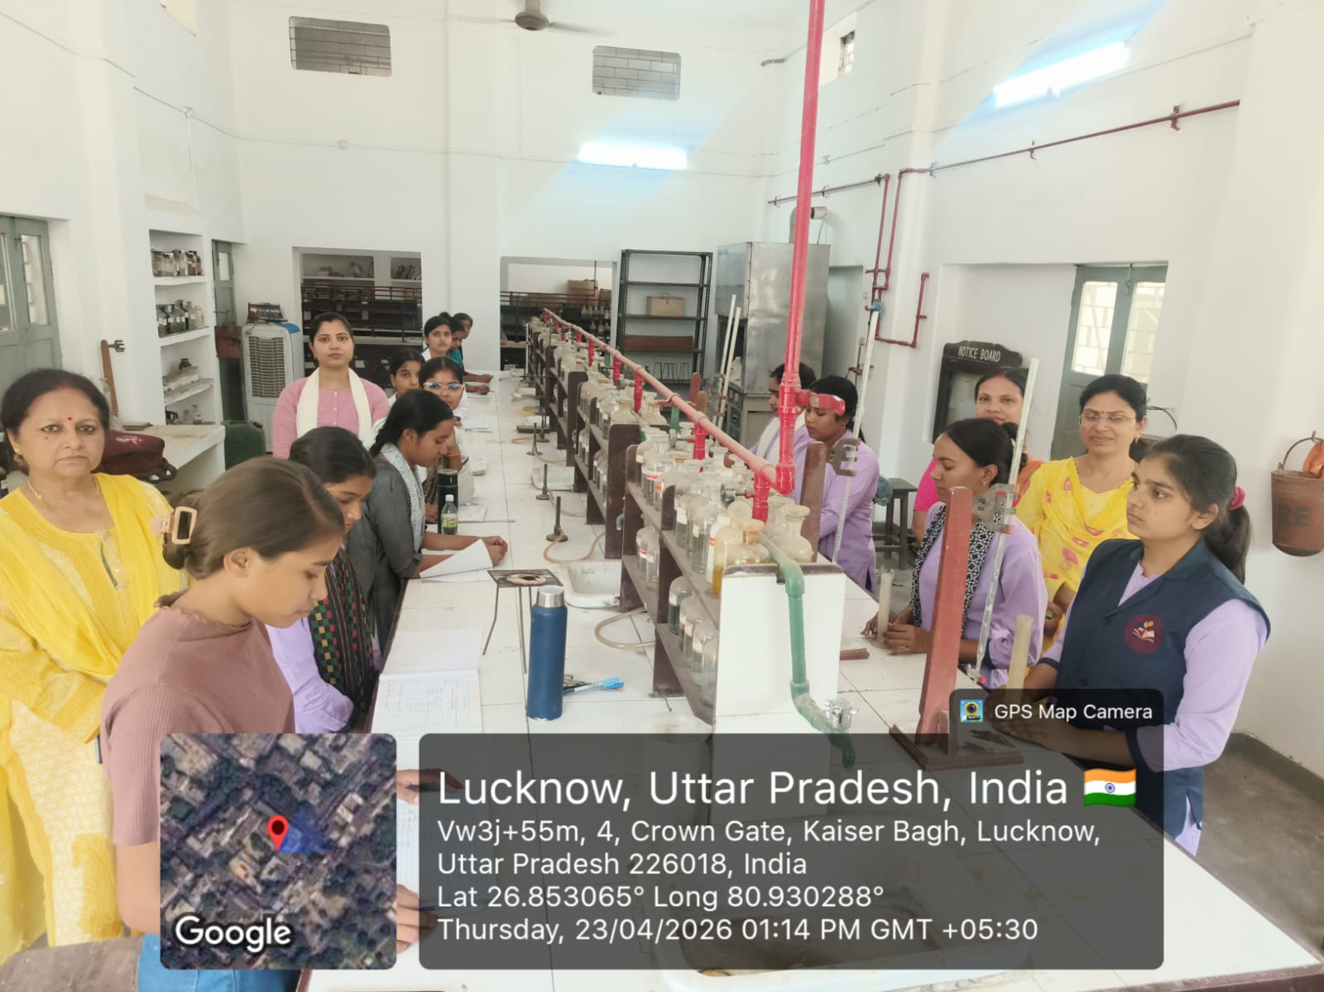
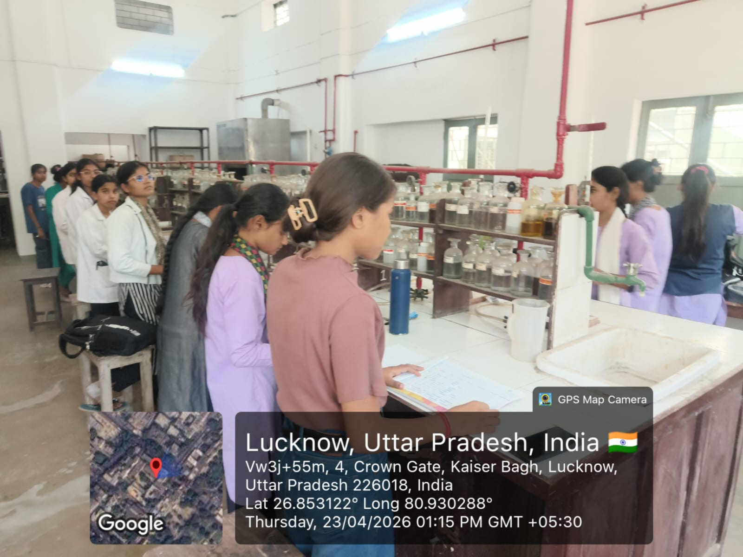
CHEMISTRY LAB

Slide 25
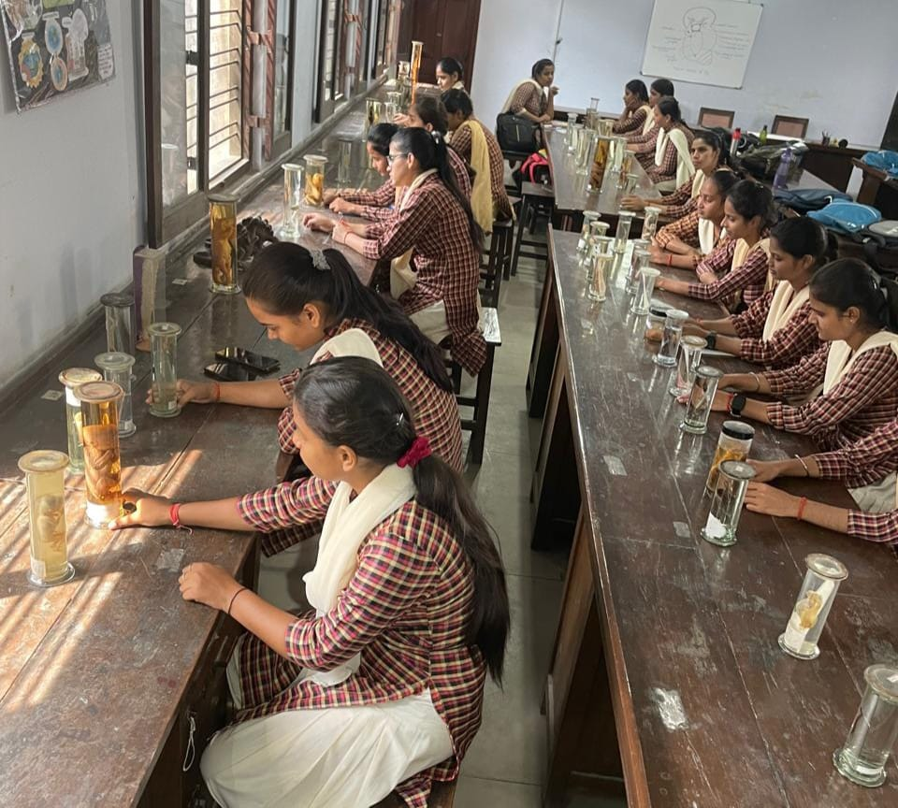
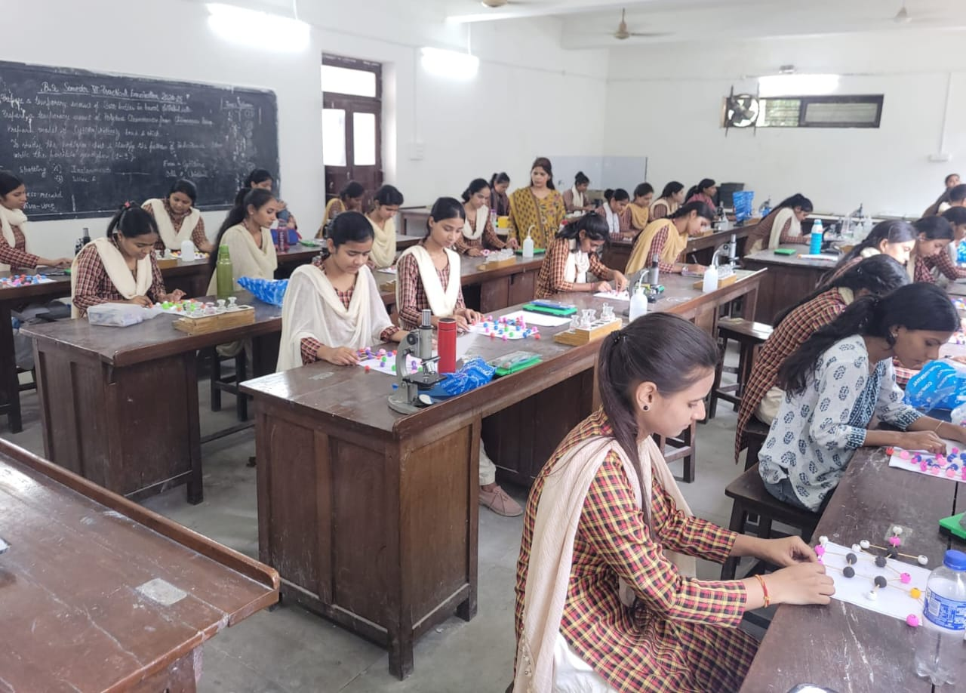
ZOOLOGY LAB

Slide 26
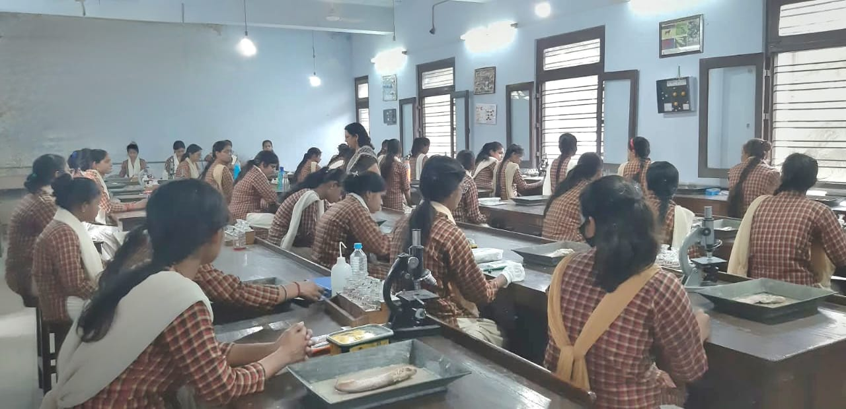
ZOOLOGY PRACTICAL LAB

Slide 27
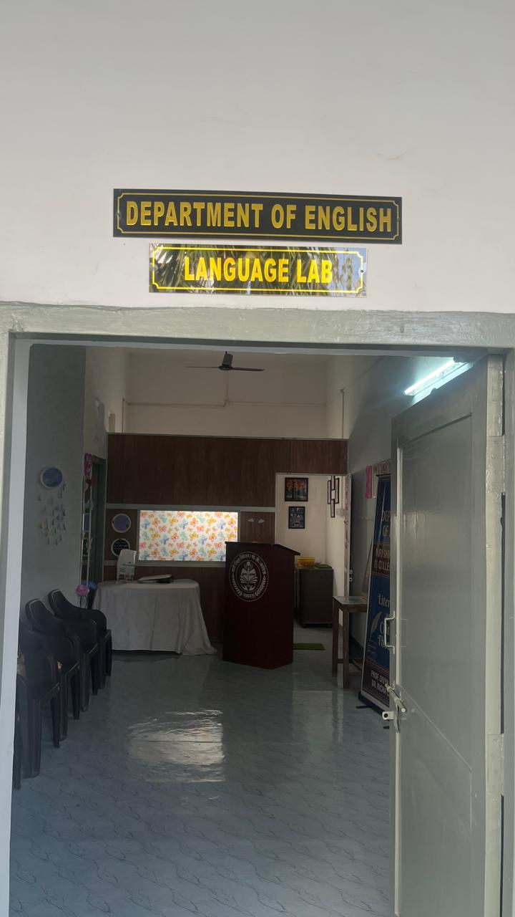
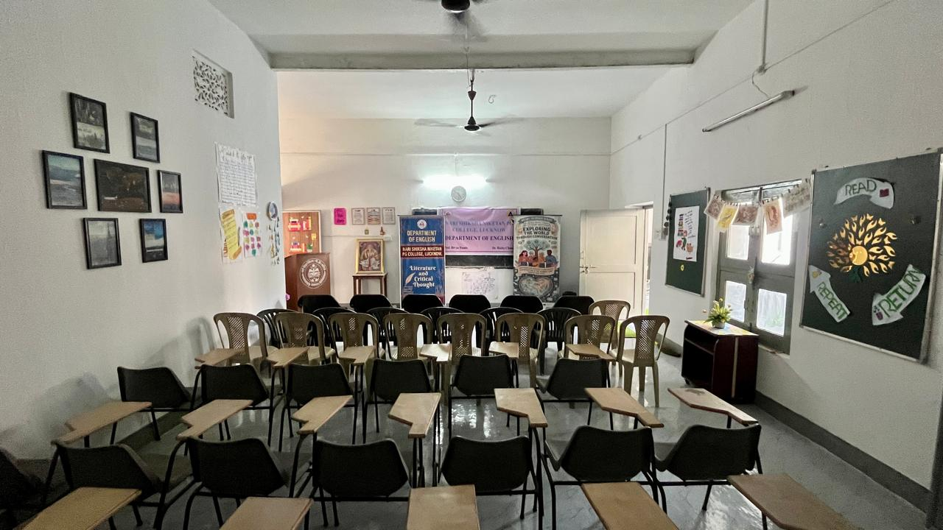
LANGUAGE LAB (DEPARTMENT OF ENGLISH)

Slide 28
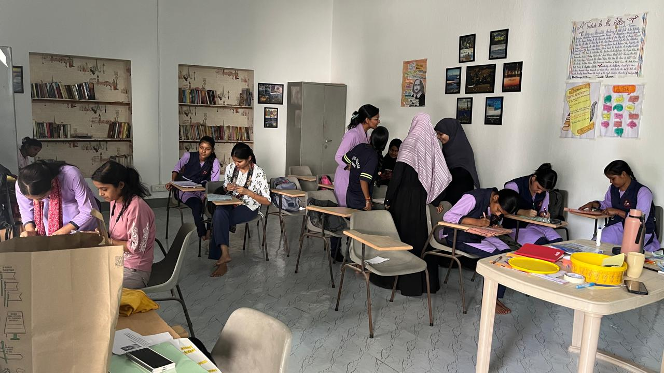
LANGUAGE LAB

Slide 29
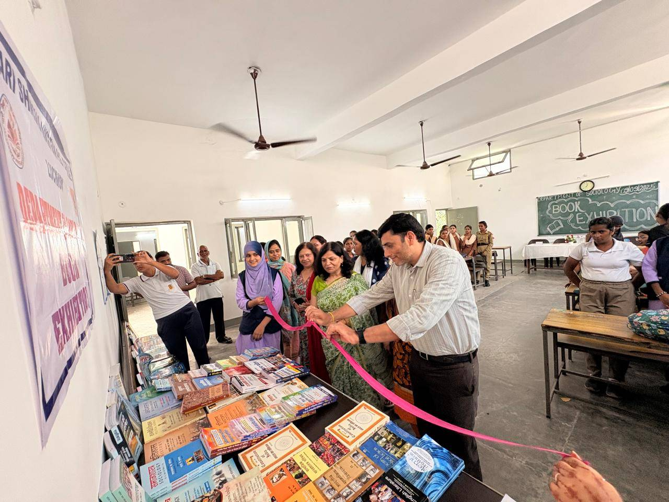
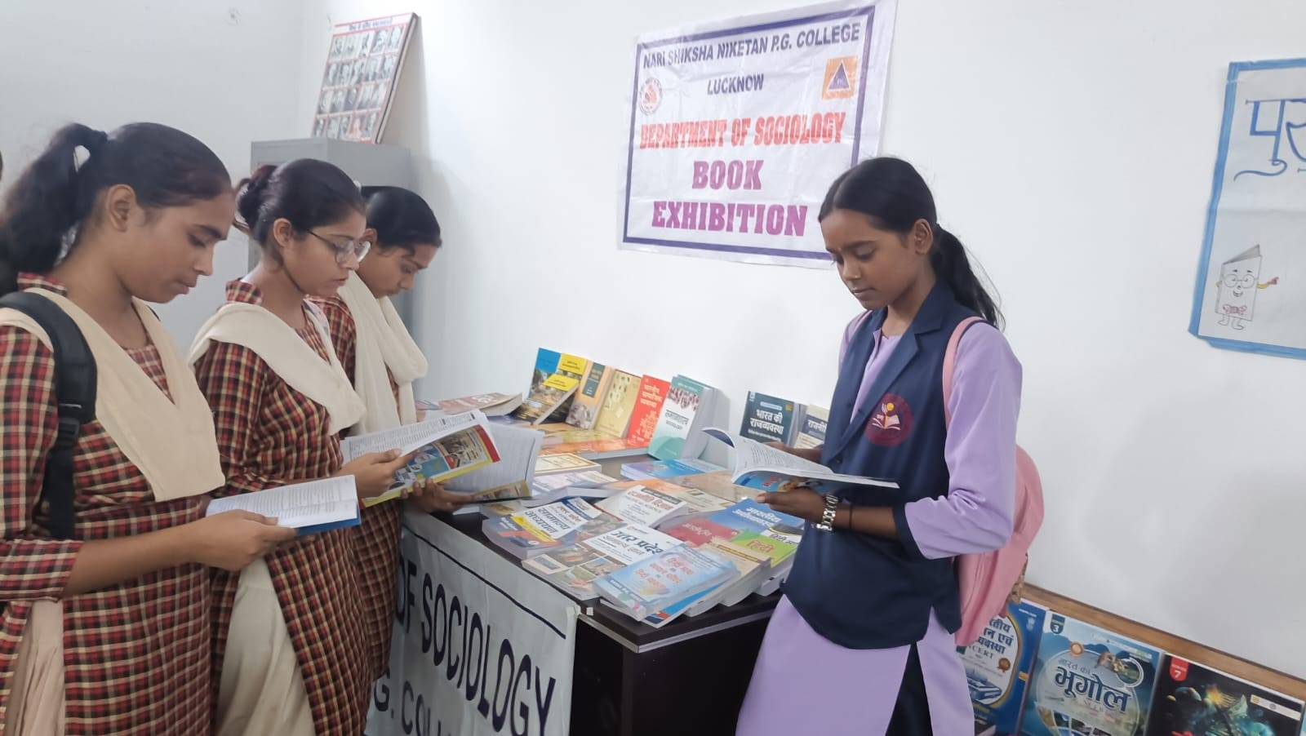
Book exhibition organised by the Sociology Department

Slide 30
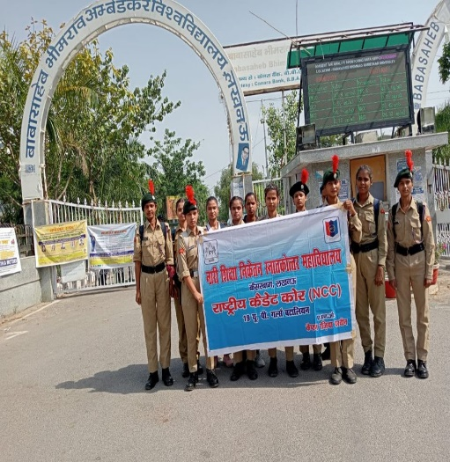
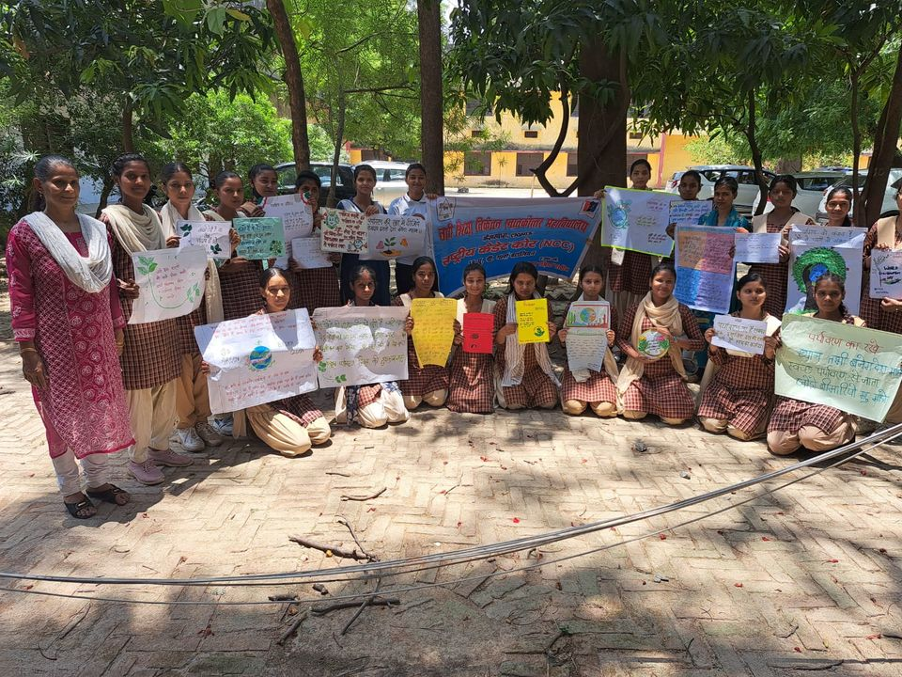

National Cadet Corps (NCC)
The 19th UP Battalion of NCC

Slide 31




NSS

Slide 32





Cultural, Founder week & Annual Function
Session- 2023-2026

Slide 33







News Paper Cutting

Slide 34





Mission Shakti
Session- 2023-2026

Slide 35




Har Ghar Tiranga
Session- 2023-2026

Slide 36


Madata Jagrukta (SVEEP)
Session- 2023-2026

Slide 37




Yoga day

Slide 38




Field trip & Excursion
Session- 2023-2026

Slide 39


Field trip & Excursion

Slide 40




Field trip & Excursion
Session- 2023-2026

Slide 41


EDUCATIONAL FIELD TRIPS

Slide 42


Educational Tour organised by the AIH Department

Slide 43





Student Seminar
Session- 2023-2026

Slide 44



STUDENT’S PRESENTATION

Slide 45


MIDTERM EXAMS

Slide 46

WORLD ANTHROPOLOGY DAY CELEBRATION TO KNOW PVTG’s of INDIA

Slide 47


Internship with family counseling Cell

Slide 48



Slide 49



Results

Slide 50
RESULTS
Session 2022-23
BA Sem 6 – 73%
BSc Sem 6- 59%
B.Com sem6- 50%
MA Sem 4- 100%
Session- 2023-24
BA Sem 6 – 81.7%
BSc Sem 6- 71.16%
B.Com sem6- 66.5%
MA Sem 4- 100%
Session 2024-25
BA Sem 6 – 85.2%
BSc Sem 6- 75.1%
B.Com sem6 - 70%
MA Sem 4- 100%

Slide 51
STUDENTS
ENROLLEMENT
Session- 2025/26 - 518
Session- 2024/25 – 677
Session- 2023/24- 779
Session – 2022/23- 882

Slide 52

Our new Prospectus for 2026–27 has been released by our Honourable Founders

Slide 53

Our New Prospectus

Slide 54

VISION -MISSION
Nari Shiksha Niketan PG college’s vision is to empower young women through education, fostering self-reliance, leadership, and holistic growth, while its mission focuses on academic excellence, skill development, and nurturing confident, socially responsible individuals ready to contribute meaningfully to society, aligning with the Nari Sewa Samiti's legacy of service for women.

Slide 55

Principal Prof. Sunita Kumar
delivered a presentation to the Hon'ble Governor Smt. Anandiben Patel, and the Education Ministers..

Slide 56

Principal and IQAC Committee members in one frame with the Hon'ble Governor, Smt. Anandiben Patel, the Hon'ble Education Ministers, and the Vice-Chancellor of Lucknow University.

Slide 57

Behind this hard work: The Team Prof. Sunita Kumar (Principal),
Prof. Divya Pande, Dr Neha Singh and Dr Kanchan.

Slide 58
THANK YOU
PROF. SUNITA KUMAR, PRINCIPAL &
IQAC TEAM

